Slide 1
iOS watching you: Automated analysis of “zero-touch” privacy violations under iOS
Benjamin Altpeter, 2021-08-03

Slide 2
Quick recap and introduction
Previous research [Altpeter, Wessels] on Android to answer how common tracking in apps is actually.
Built framework to automatically install and run apps for 60 seconds and collect their network traffic.
Thus, looked at tracking that happens without consent (as there was no user input).
Analysis of 1,296 apps showed that automated data collection in the background is common in Android apps. Apps commonly transmit device details, sensor data, events, or even the geolocation and which data is entered in the app; often to third-parties.
On iOS (often hailed as more privacy-friendly), research into privacy violations by apps is scarce and outdated.
I have thus repeated our previous research for iOS using a very similar approach to allow for comparisons.

Slide 3
Quick GDPR recap
GDPR concerns itself with processing of personal data (explicitly broad terms)
Legal basis (Art. 6(1) GDPR) needed to process personal data
in practice, processing in apps is usually based on consent or legitimate interest
but supervisory authorities say that consent is necessary for tracking in most cases
Recital 32 mandates conditions for consent: “Consent should be given by a clear affirmative act [...]. Silence, pre-ticked boxes or inactivity should not therefore constitute consent. [...]”
Schrems II ruling by the ECJ (July 2020) makes it almost impossible to legally transfer data to the US
thus: tracking with US providers most likely illegal, especially without consent

Slide 4
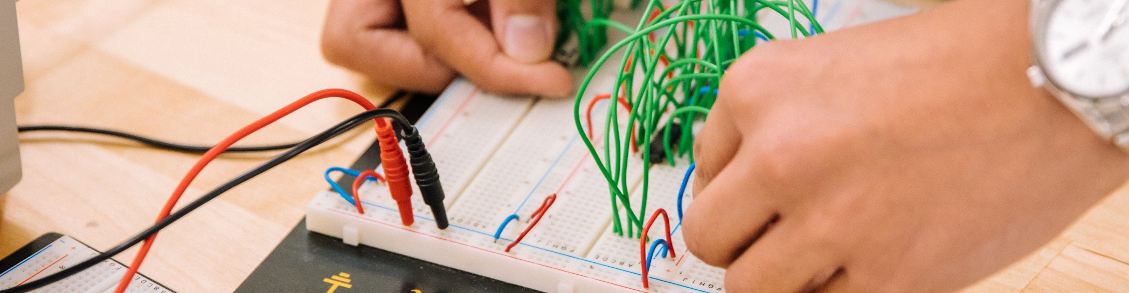
Method
Image: Jeswin Thomas (Unsplash license)

Slide 5
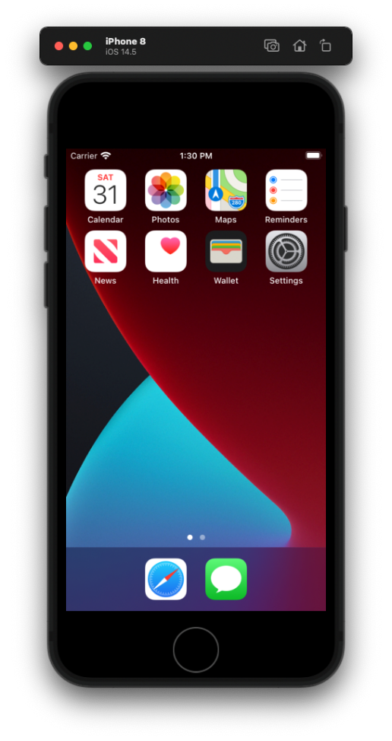
Is emulation an option?

Slide 6
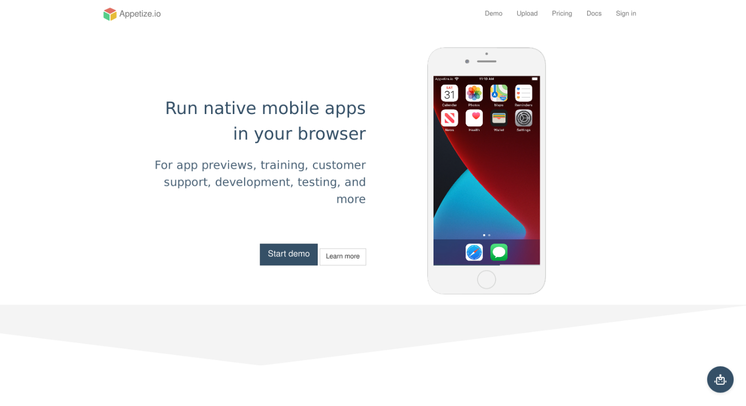
Maybe commercial providers can help?
https://appetize.io/

Slide 7
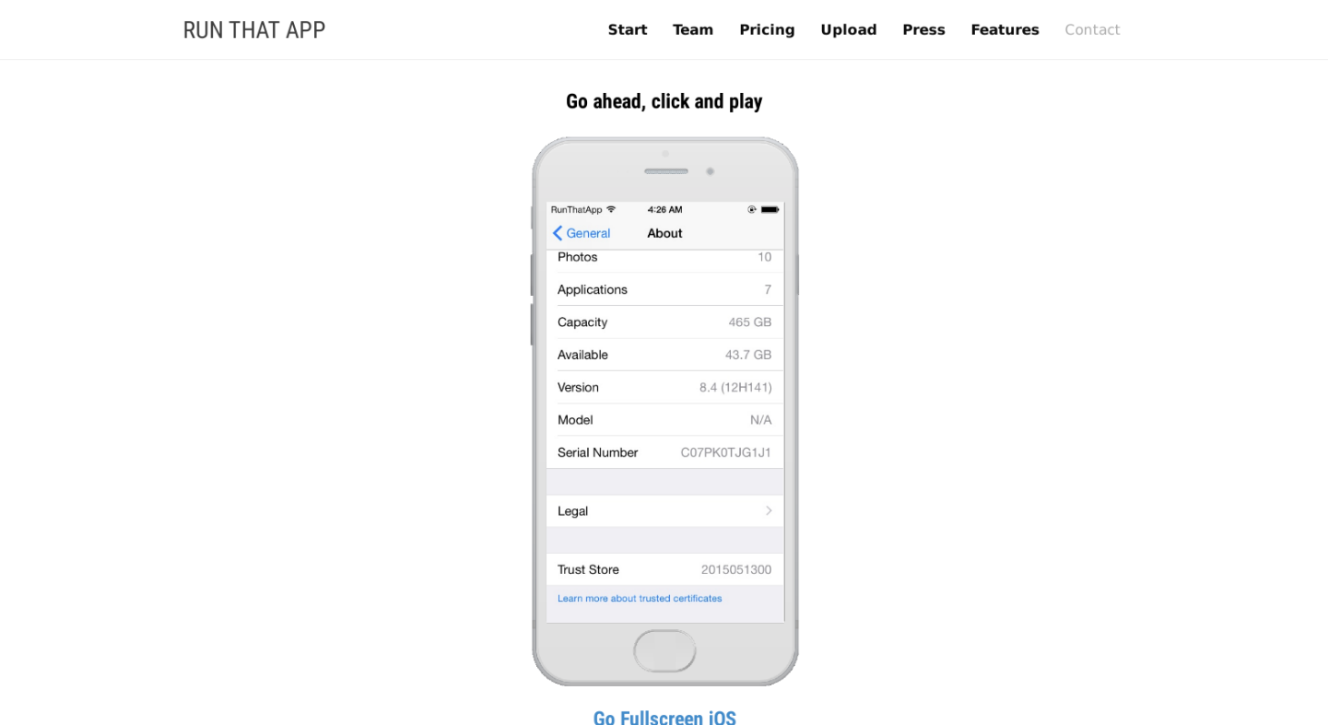
Maybe commercial providers can help?
https://www.runthatapp.com/demo/

Slide 8
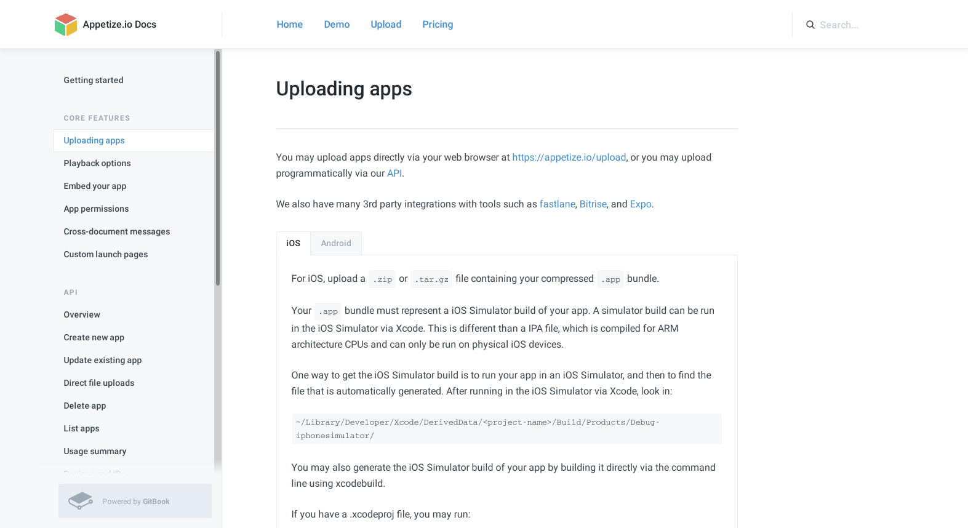
Maybe commercial providers can help?
https://docs.appetize.io/core-features/uploading-apps

Slide 9
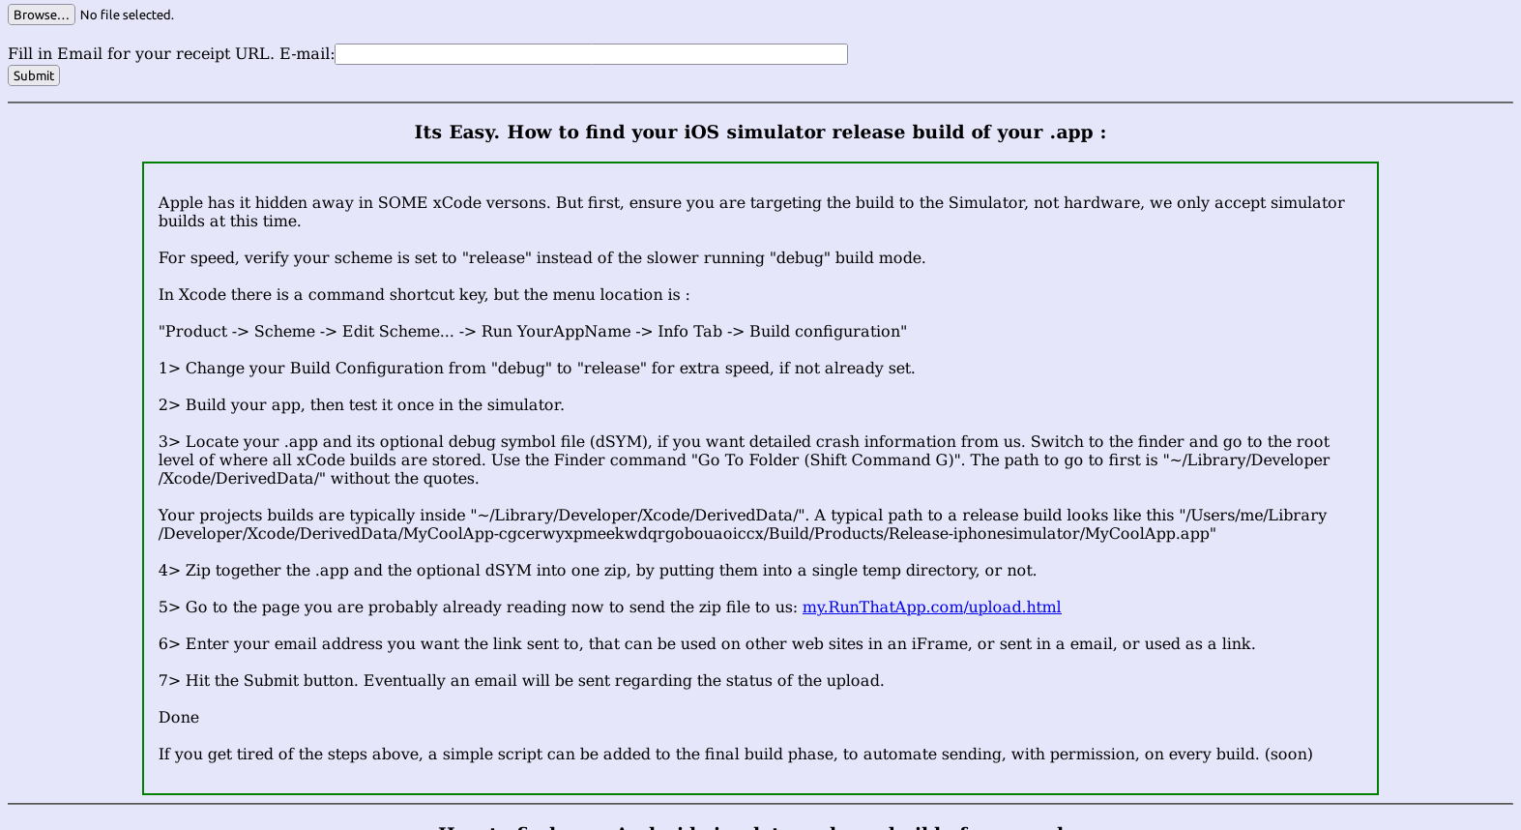
Maybe commercial providers can help?
http://upload.runthatapp.com/upload.html

Slide 10
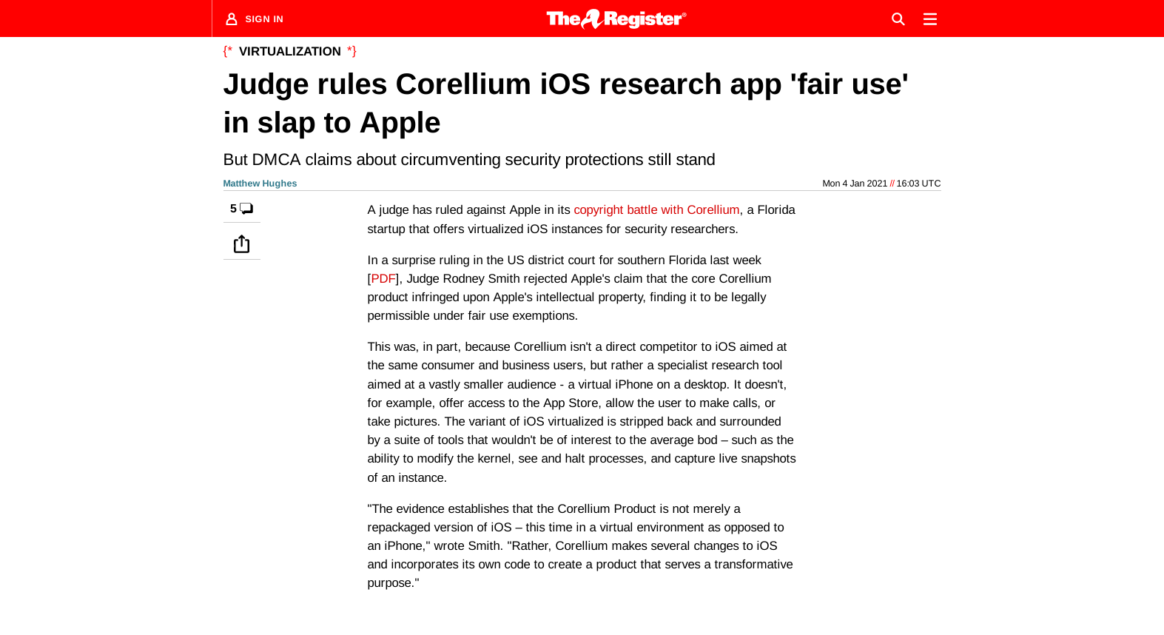
What about Corellium?
https://www.theregister.com/2021/01/04/corellium_ios_ruling/

Slide 11
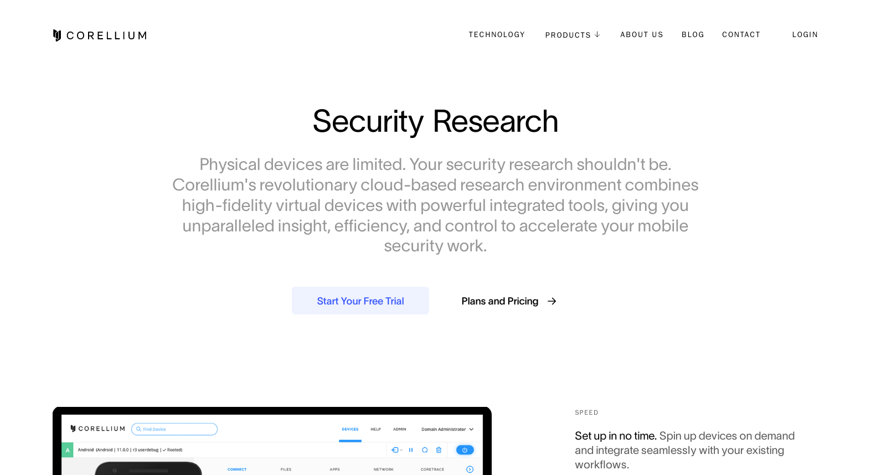
What about Corellium?
https://corellium.com/security-research

Slide 12
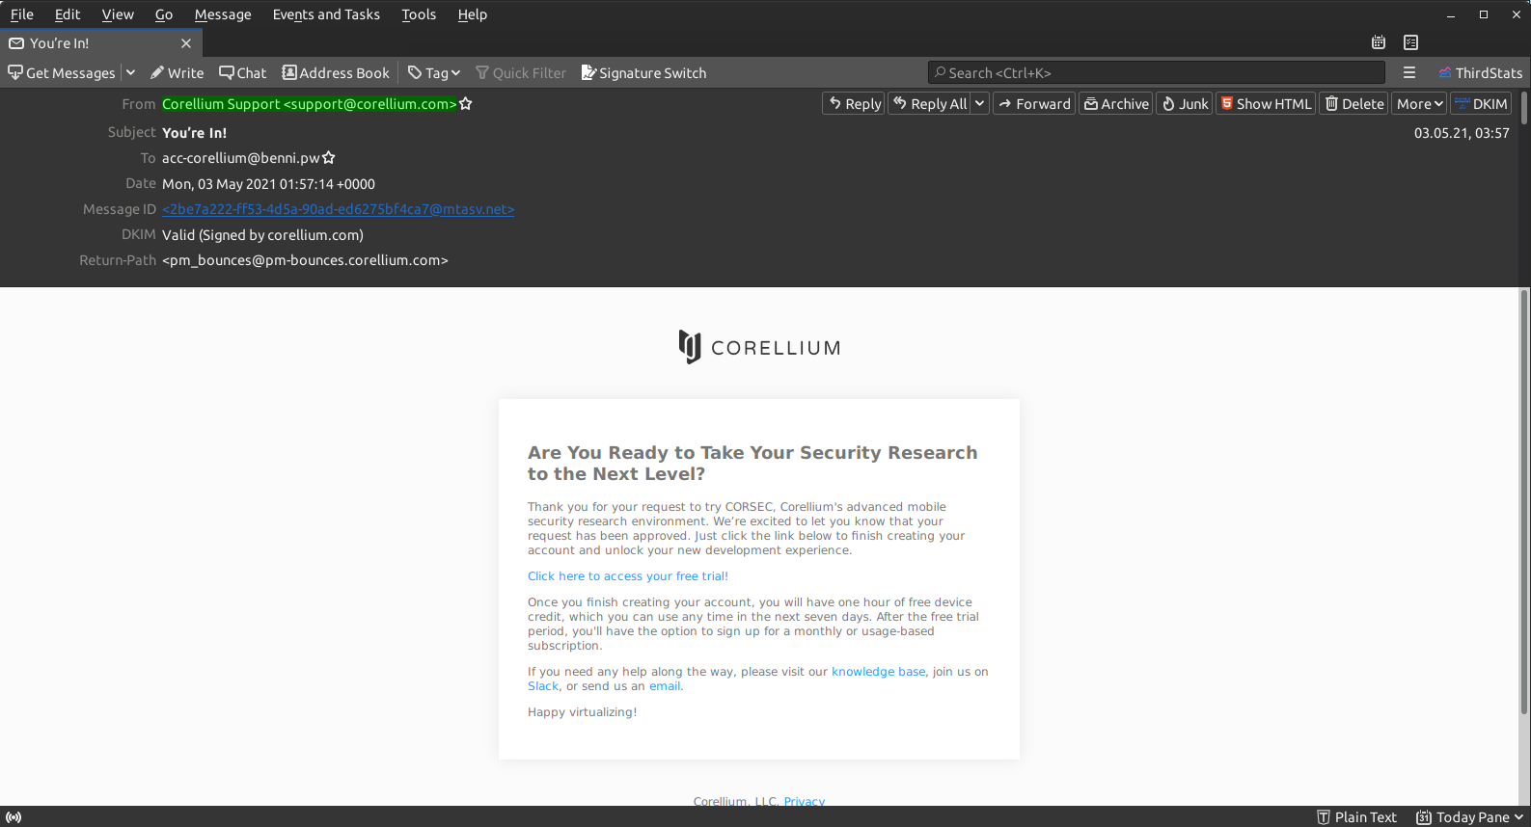
I’m in!

Slide 13
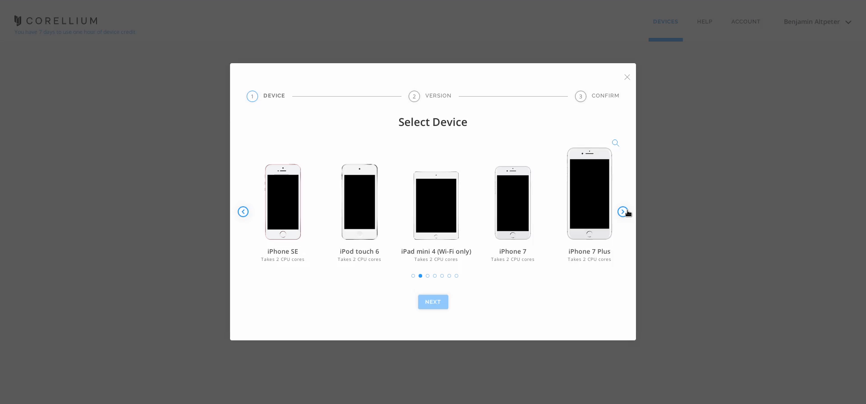
I’m in!
https://app.corellium.com/

Slide 14
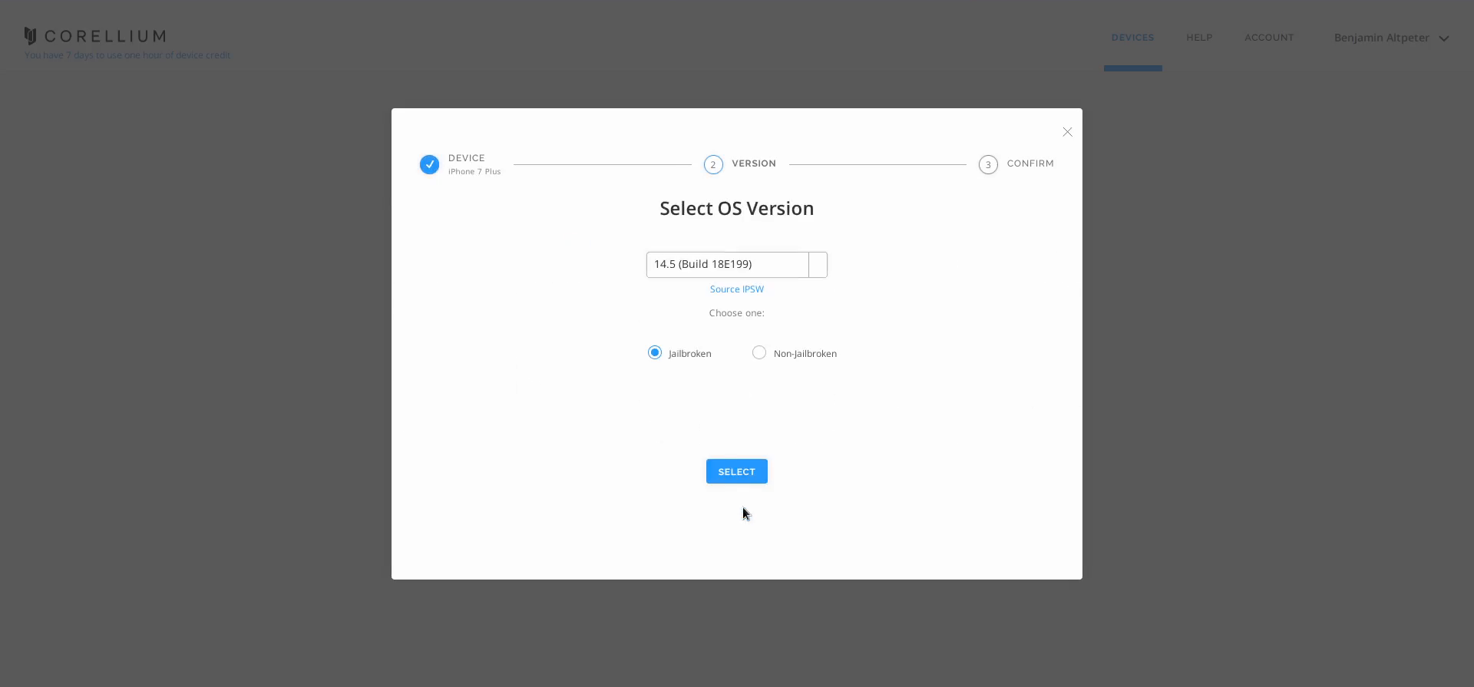
I’m in!
https://app.corellium.com/

Slide 15
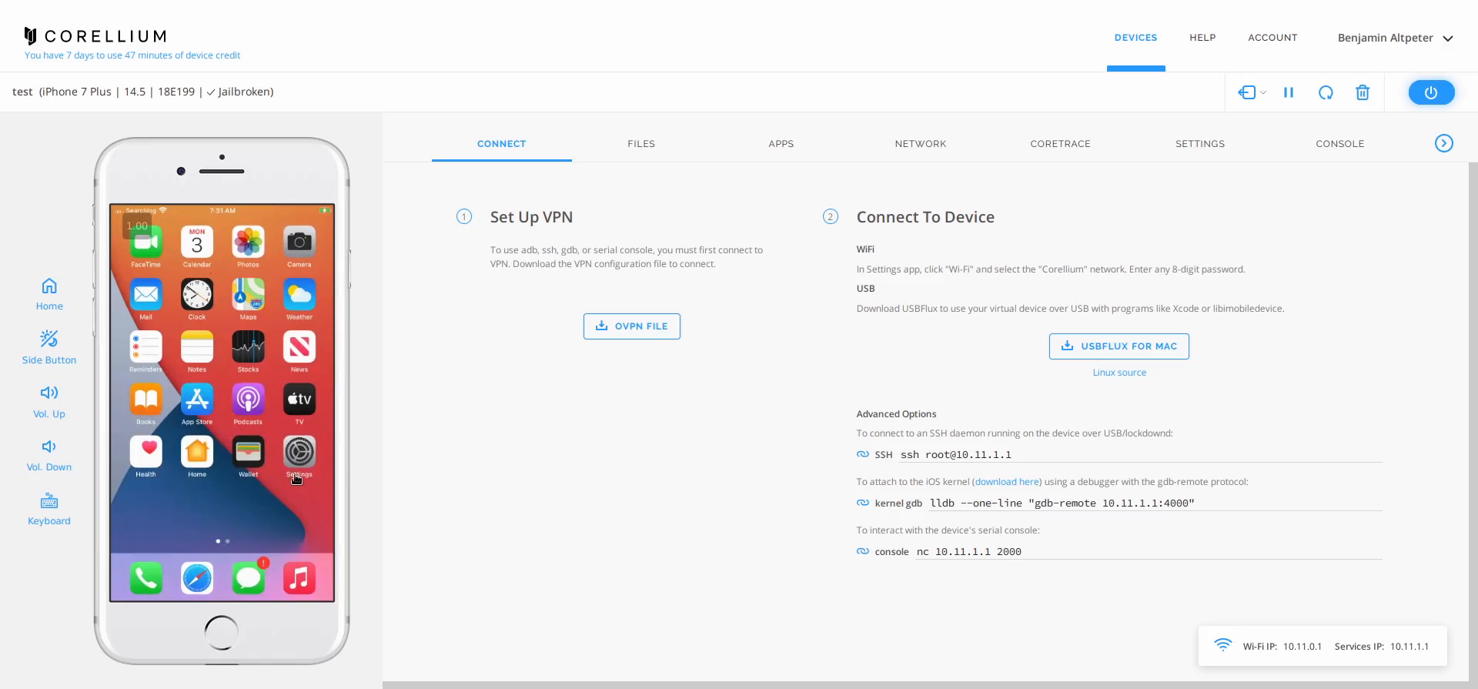
I’m in!
https://app.corellium.com/

Slide 16
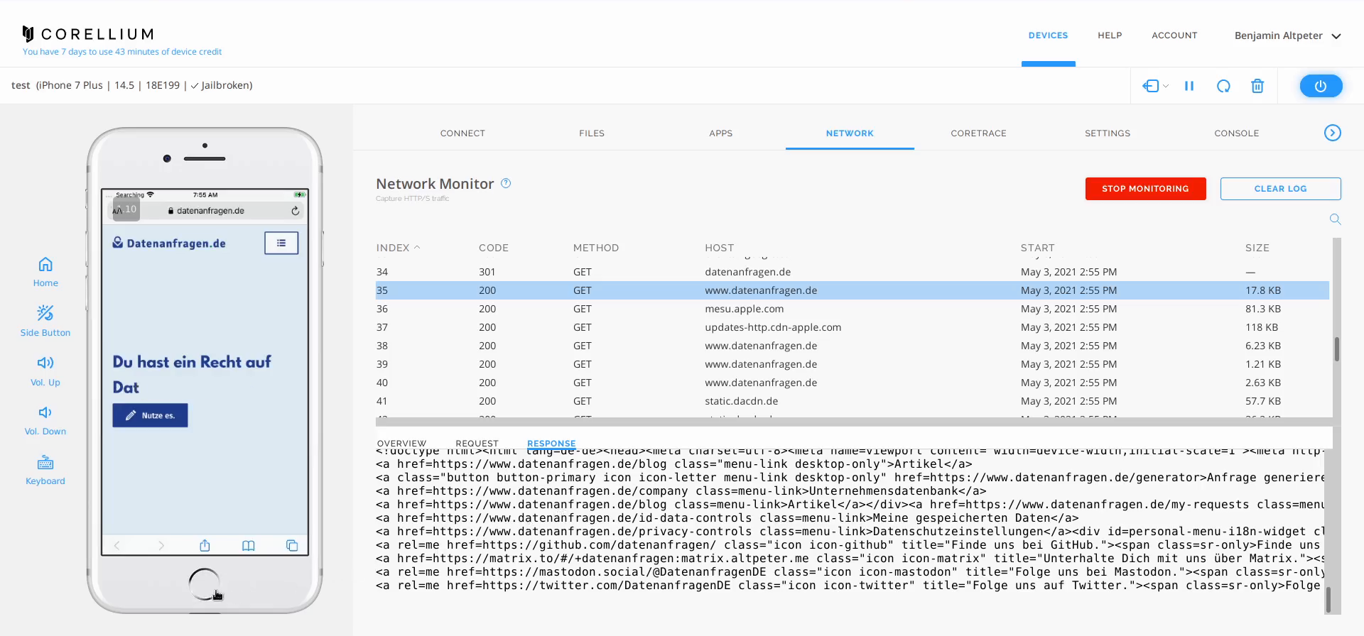
I’m in!
https://app.corellium.com/

Slide 17
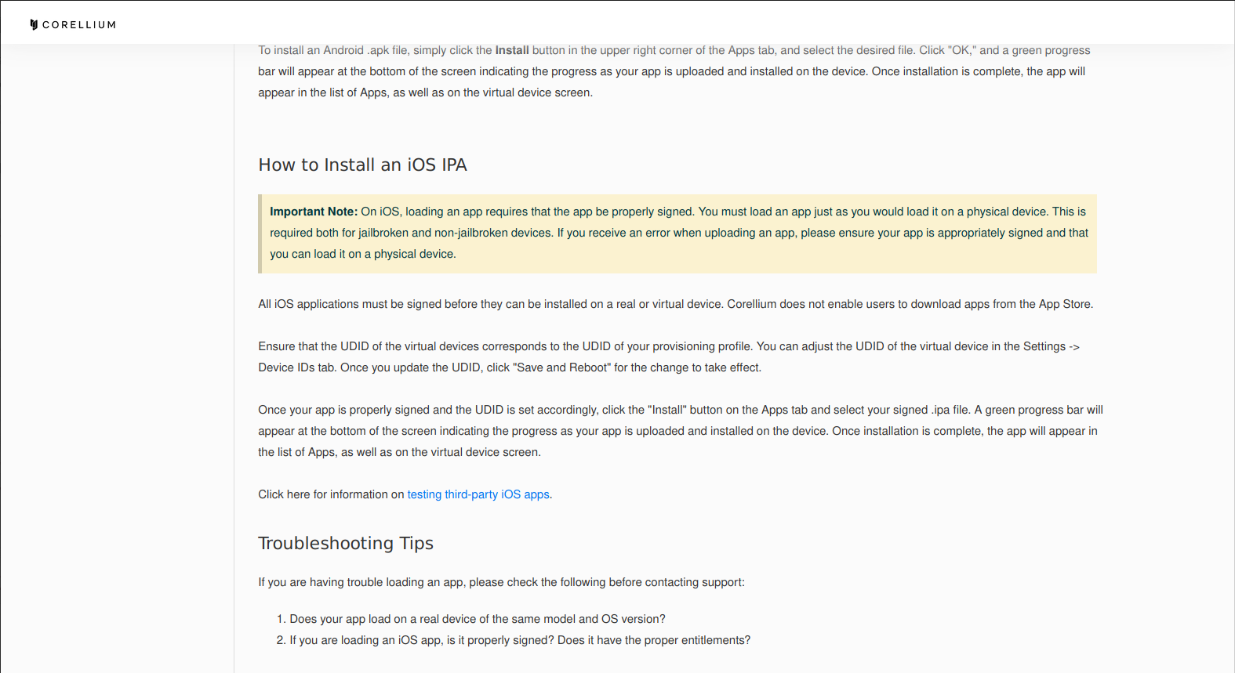
Another dead end
https://support.corellium.com/hc/en-us/articles/360051662354-Apps

Slide 18

Let’s make the device usable
https://checkra.in/

Slide 19
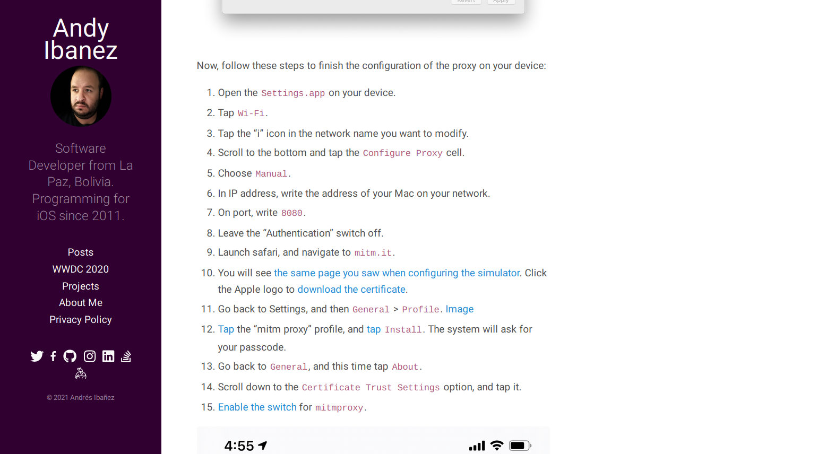
Surprisingly easy…
https://www.andyibanez.com/posts/intercepting-network-mitmproxy/#physical-ios-devices

Slide 20
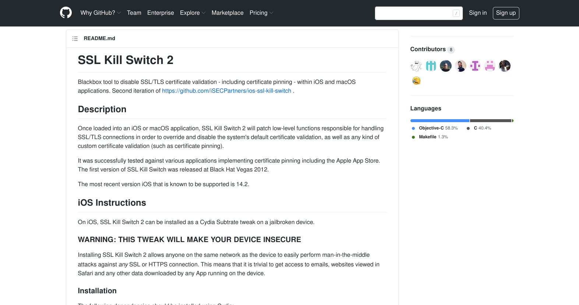
Surprisingly easy…
https://github.com/nabla-c0d3/ssl-kill-switch2

Slide 21
Obtaining apps
<?xml version="1.0" encoding="UTF-8"?> <!DOCTYPE plist PUBLIC "-//Apple//DTD PLIST 1.0//EN"
"http://www.apple.com/DTDs/PropertyList-1.0.dtd"> <plist version="1.0"> <dict> <!-- […] --> <key>artistName</key> <string>AMZN Mobile LLC</string> <key>bundleDisplayName</key> <string>Amazon Alexa</string> <!-- […] --> <key>storeCohort</key> <string>7|date=1622133000000&amp;sf=143443</string> <key>appleId</key> <string>frank.walther.1978@icloud.com</string> <key>aiBuy</key> <true/> </dict> </plist>

Slide 22
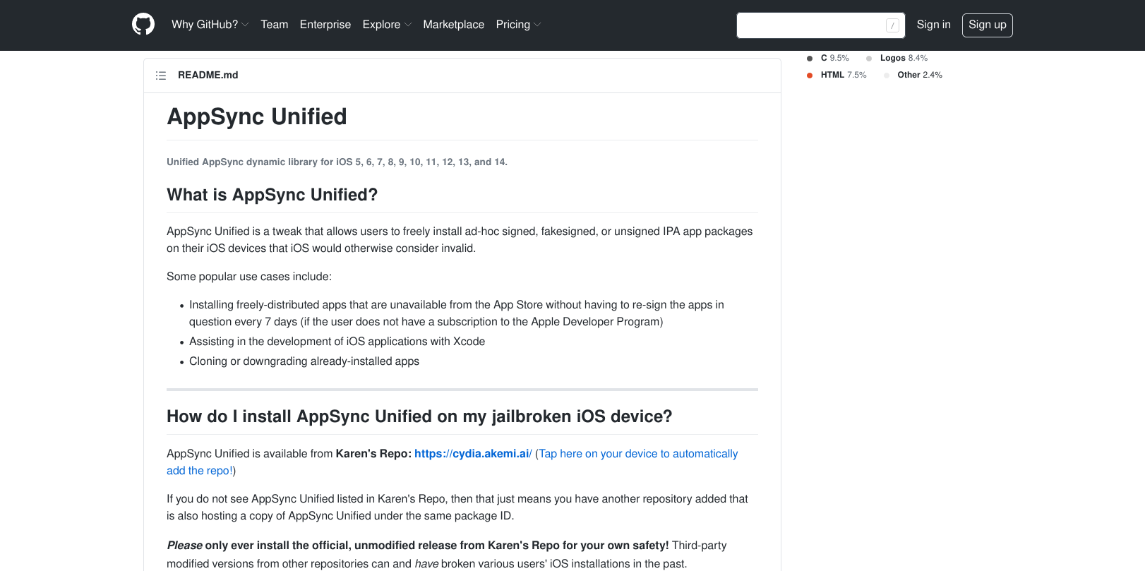
Obtaining apps
https://github.com/akemin-dayo/AppSync

Slide 23
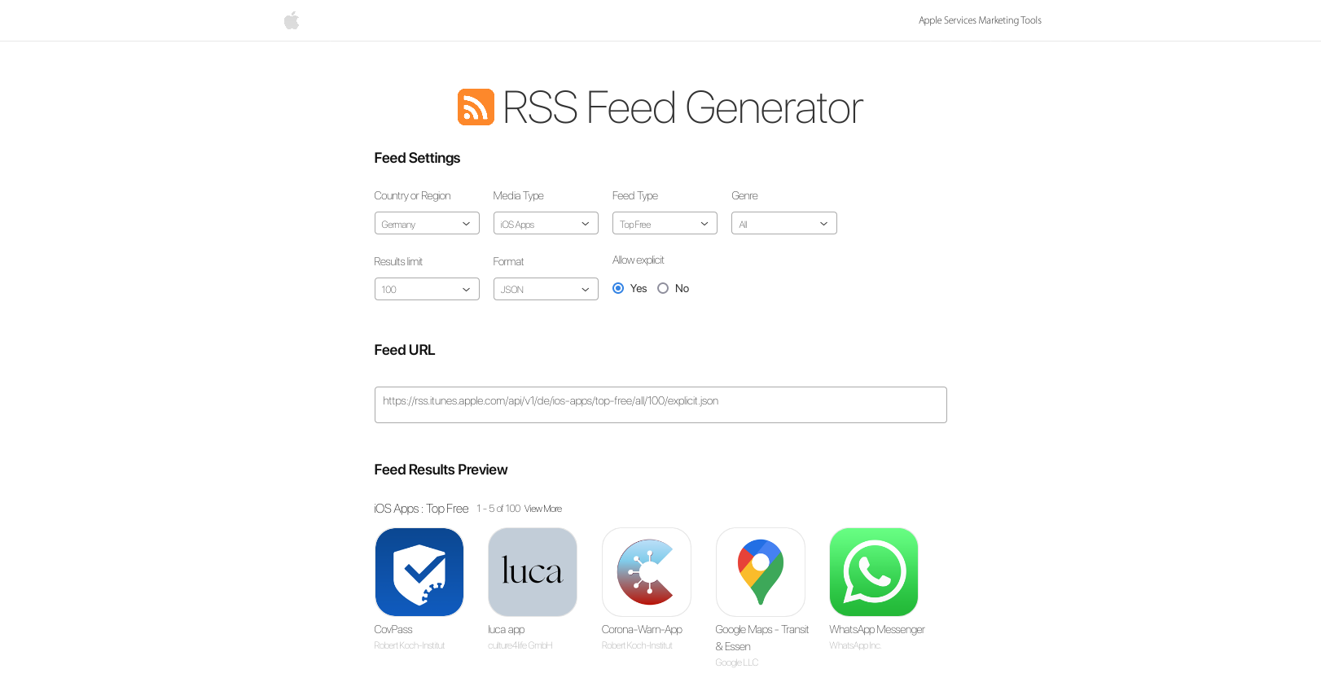
Let’s start with a wish list
https://rss.itunes.apple.com/en-us

Slide 24
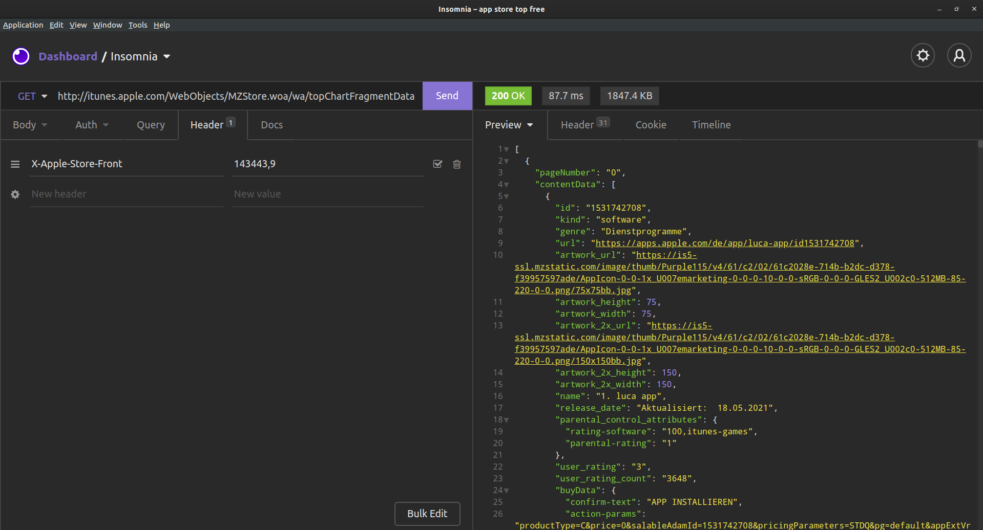
Backwards compatibility to the rescue
http://itunes.apple.com/
WebObjects/MZStore.woa/wa/topChartFragmentData
?cc=de&genreId=36&popId=27
&pageSize=120&pageNumbers=0,1,2,3,4,5,6,7,8,9

Slide 25
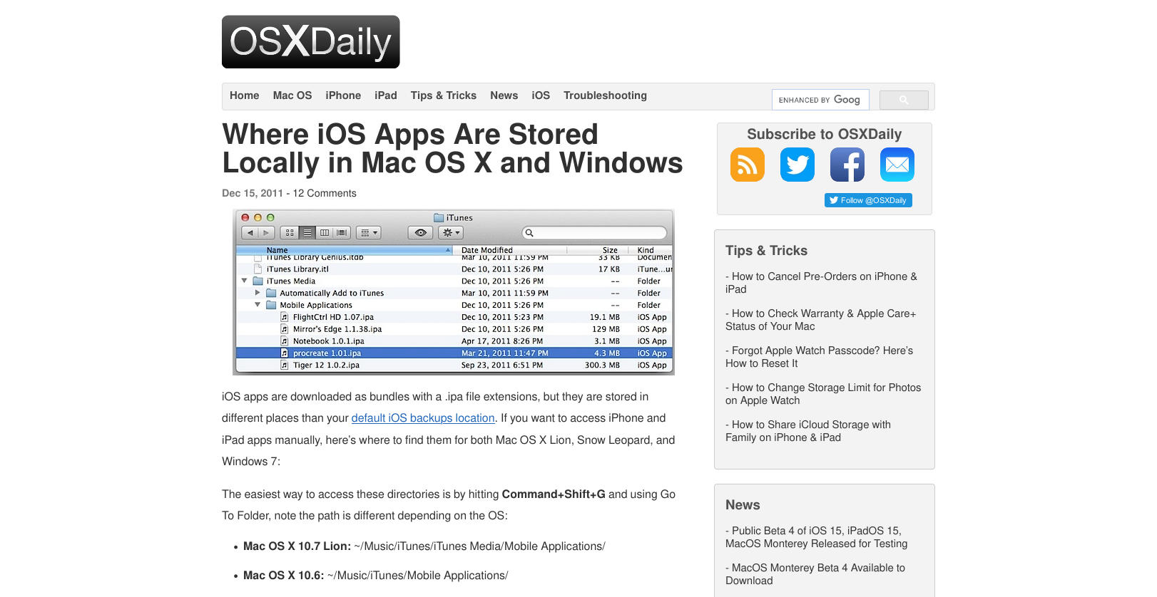
Officially supported?
https://osxdaily.com/2011/12/15/where-ios-apps-stored-locally-in-mac-os-x-and-windows/

Slide 26
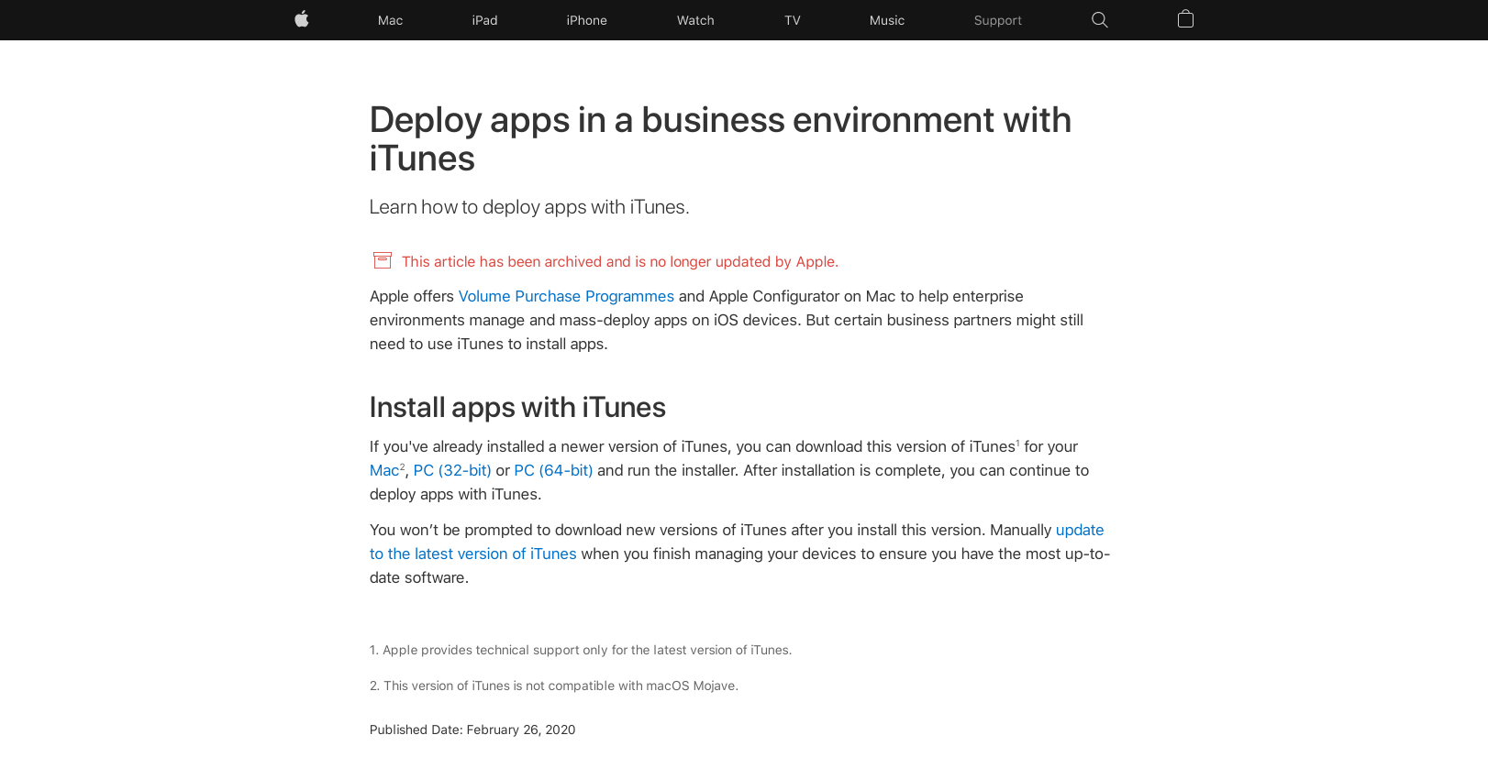
Officially supported?
https://support.apple.com/en-gb/HT208079

Slide 27
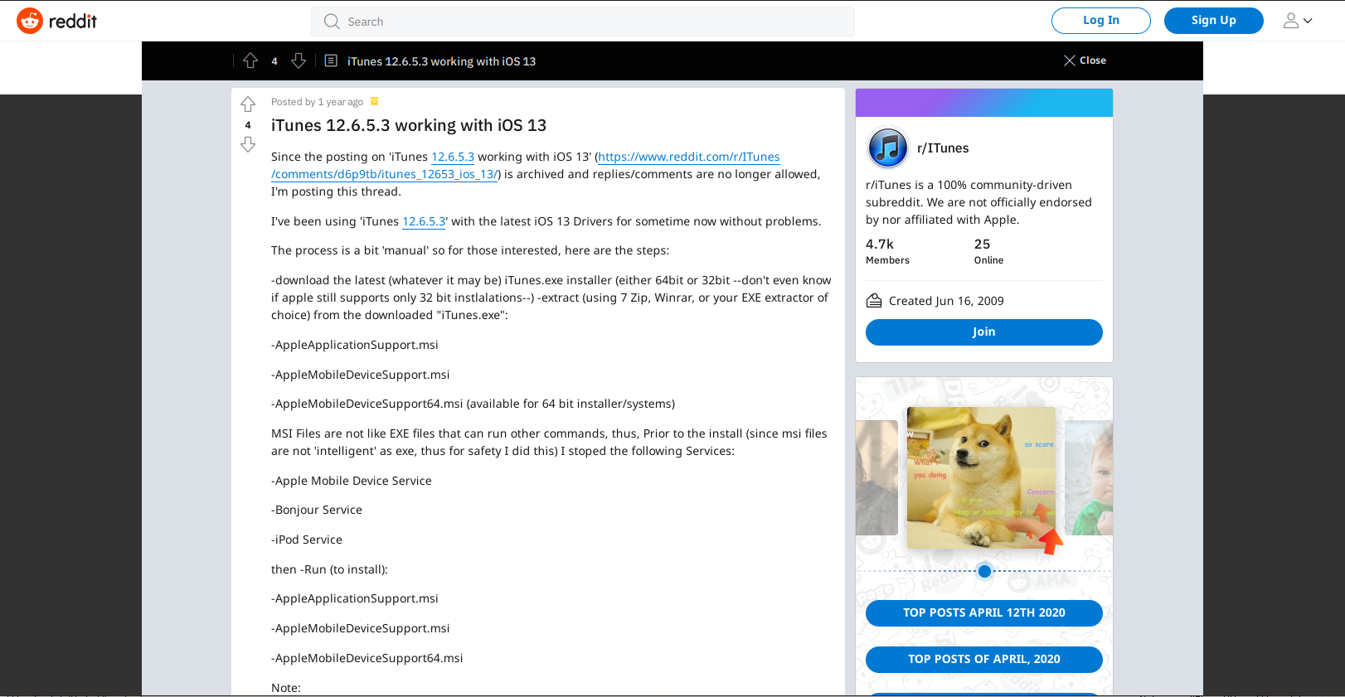
How about not so officially supported?
http://web.archive.org/web/20210527200153if_/https://www.reddit.com/r/ITunes/comments/g01qqh/itunes_12653_working_with_ios_13/

Slide 28
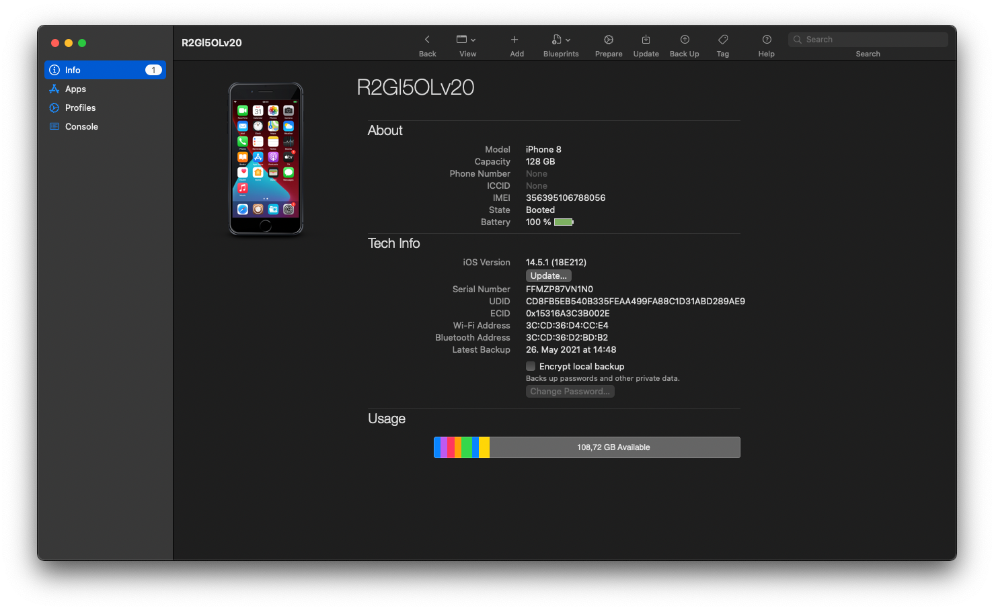
Officially supported 2.0

Slide 29
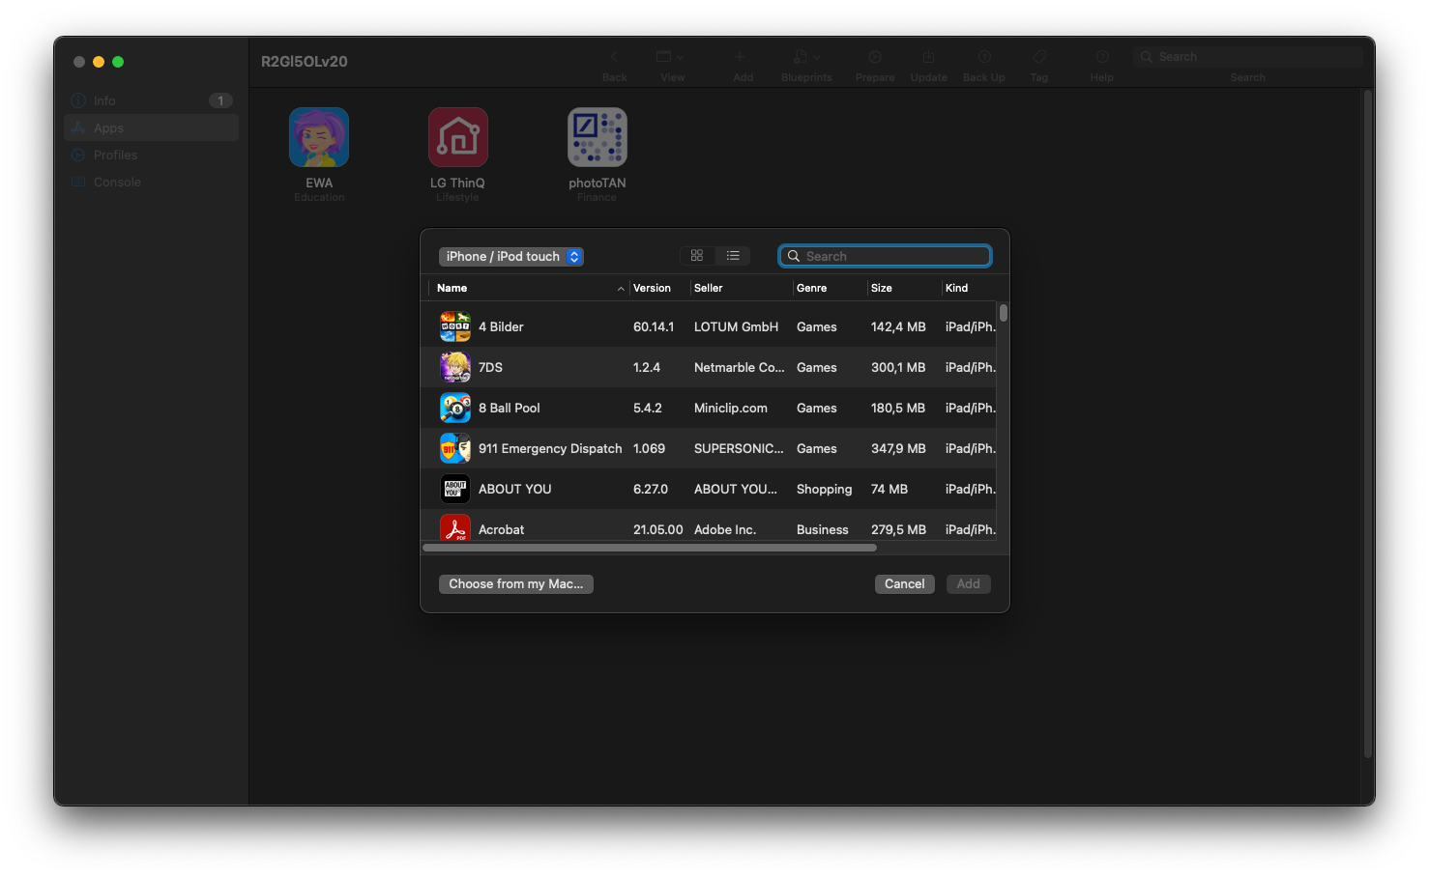
Officially supported 2.0—not quite, though

Slide 30
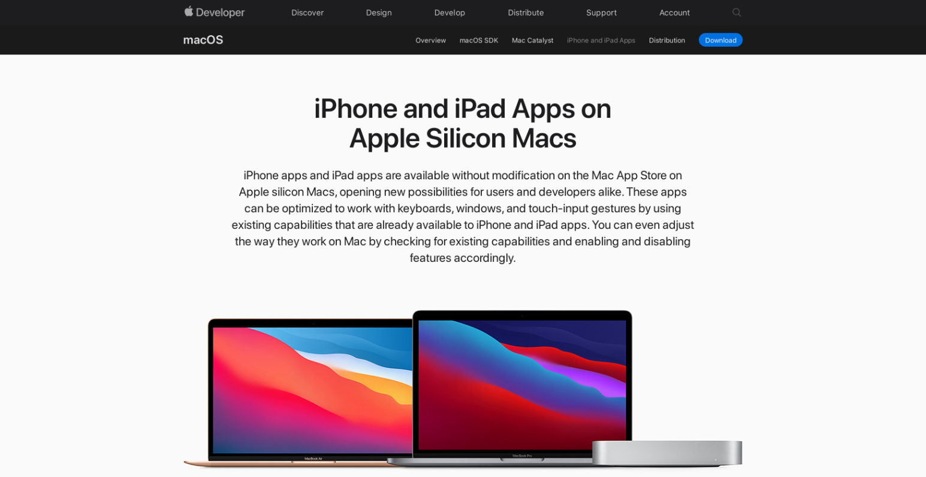
Officially supported 3.0
https://developer.apple.com/macos/iphone-and-ipad-apps/

Slide 31
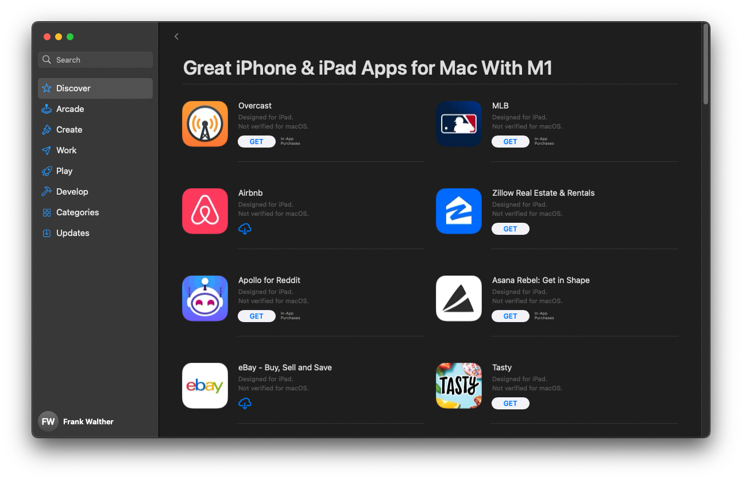
Officially supported 3.0

Slide 32
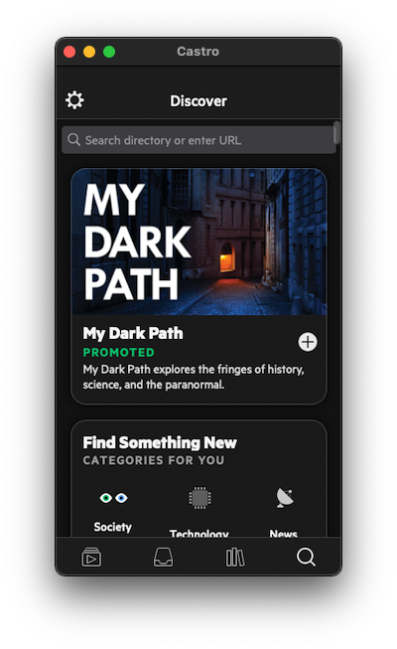
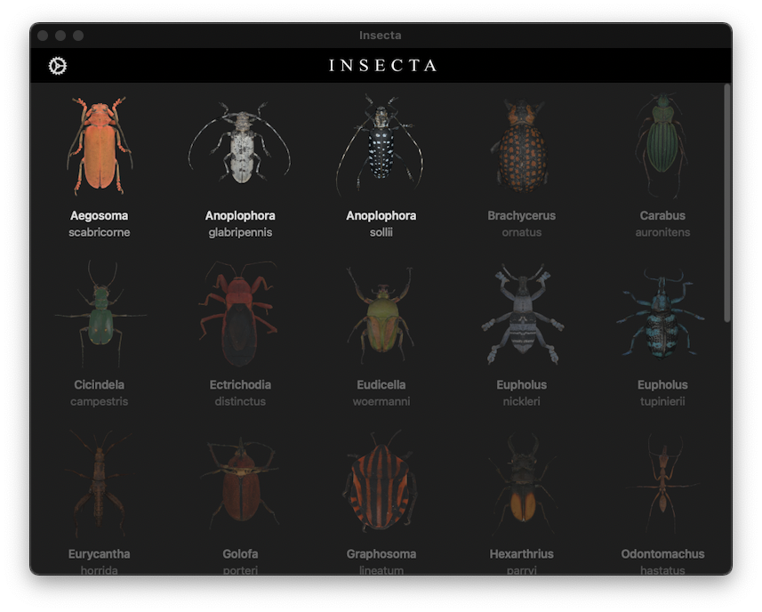
Officially supported 3.0

Slide 33
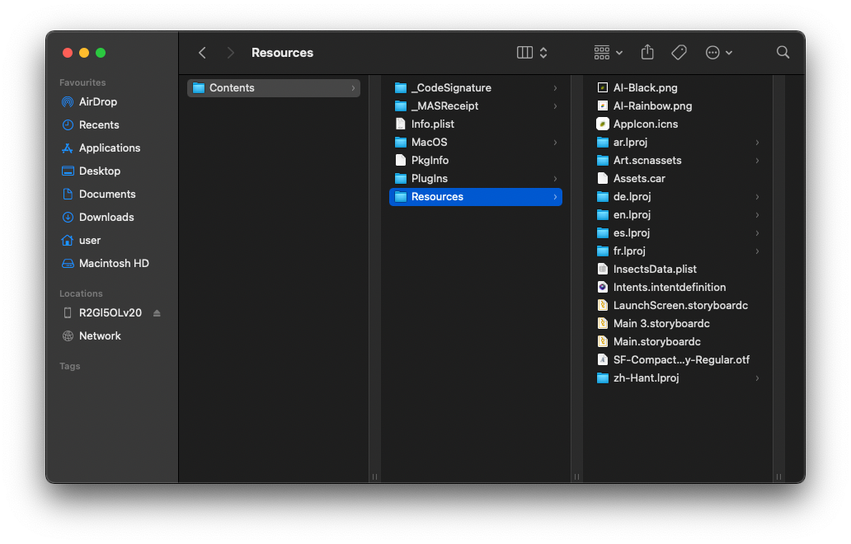
Probably just the .ipa?

Slide 34
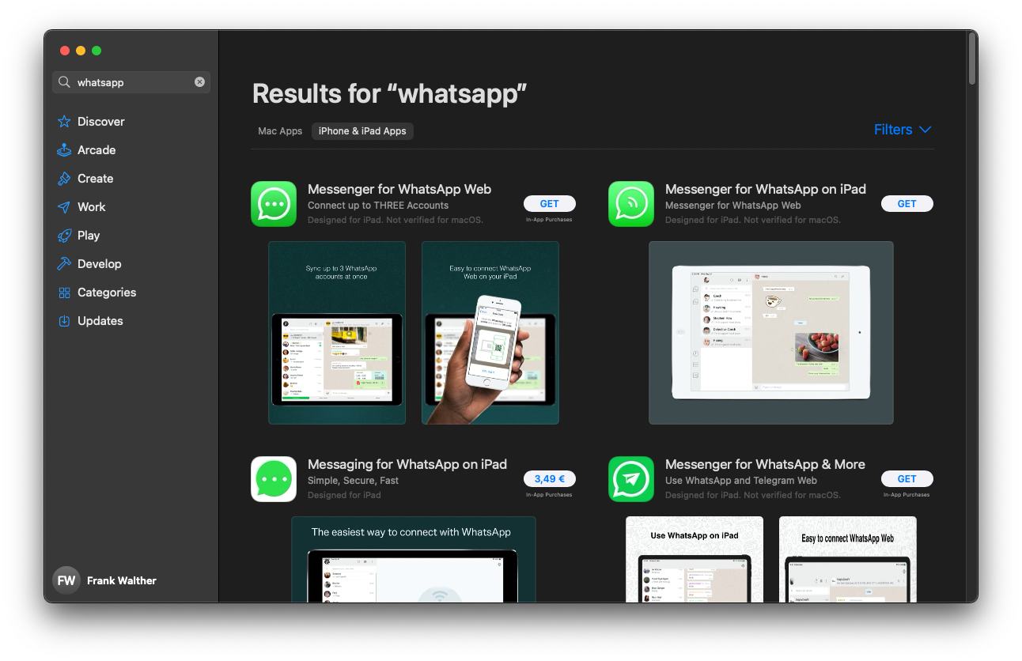
Not all of them, though

Slide 35
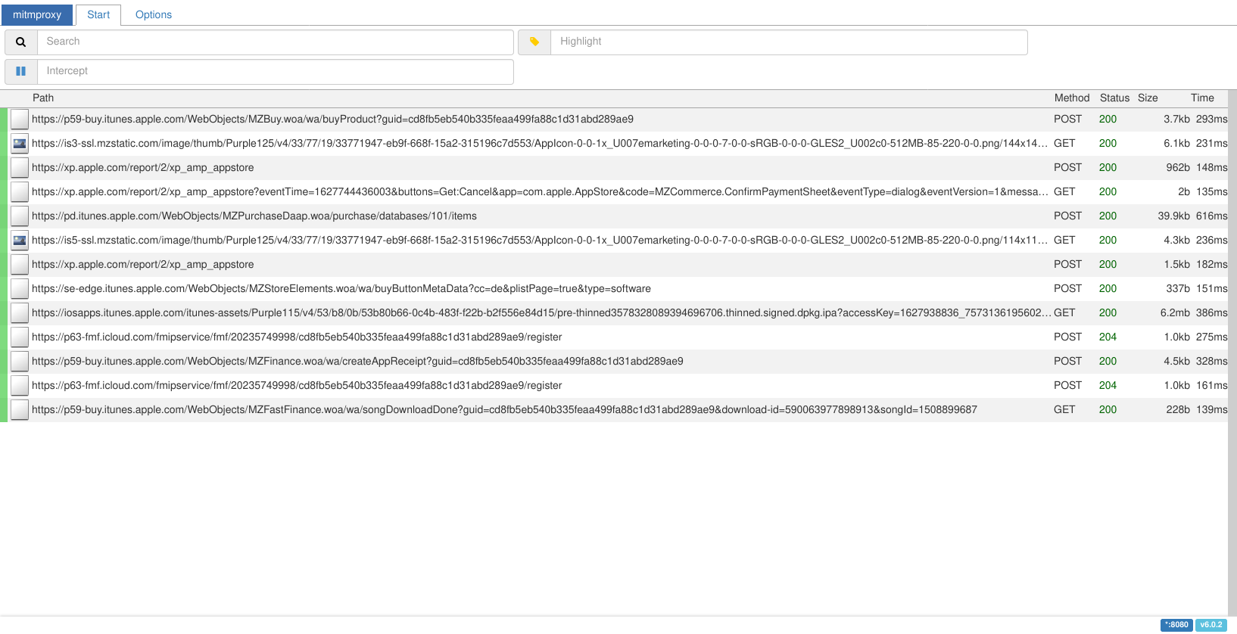
How does the App Store do it?

Slide 36
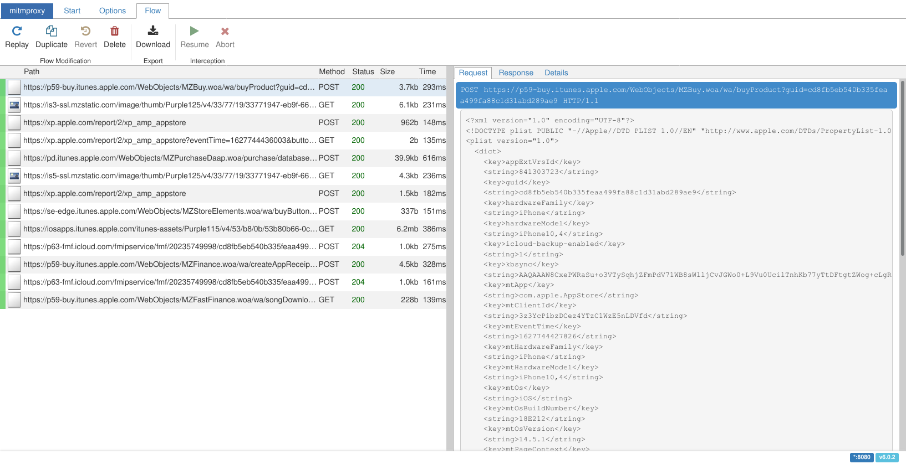
How does the App Store do it?

Slide 37
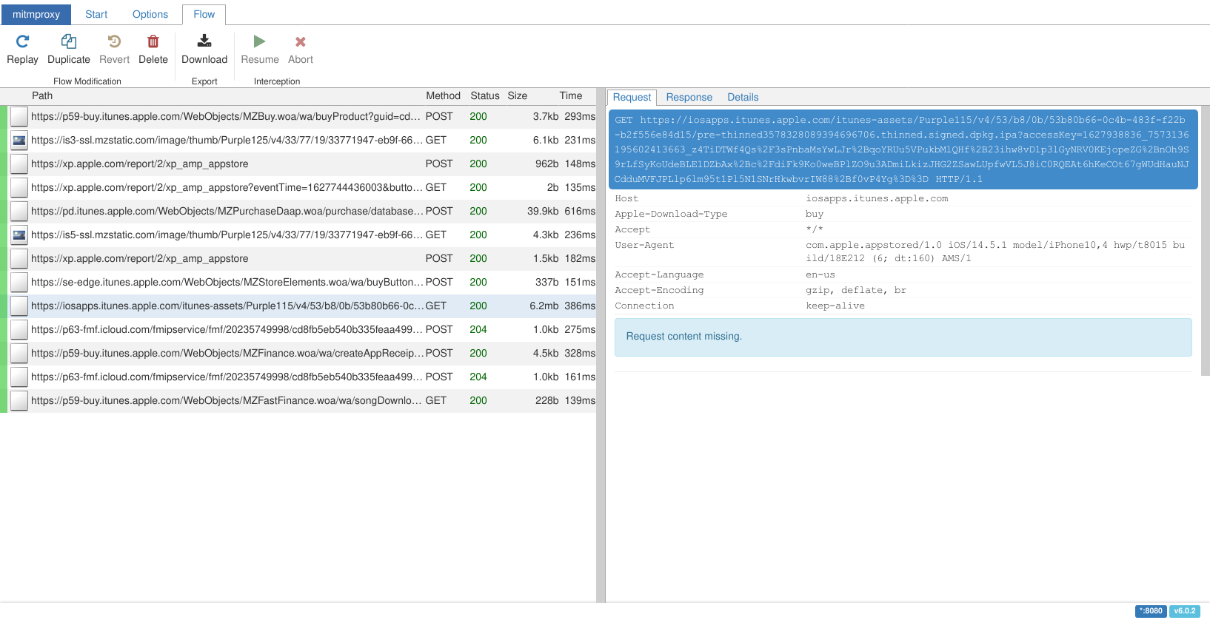
How does the App Store do it?

Slide 38
What do we actually need for the request?
<plist version="1.0"> <dict> <!-- [Not all parameters listed, some reordered.] --> <key>appExtVrsId</key> <string>841303723</string> <key>salableAdamId</key> <string>1508899687</string> <key>hardwareFamily</key> <string>iPhone</string> <key>hardwareModel</key> <string>iPhone10,4</string> <key>osVersion</key> <string>14.5.1</string> <key>kbsync</key> <string>AAQAAAW8CxePWRaSu+o3VTySqhjZFmPdV71WB8sWlljCvJGWo0+L9Vu0UcilTnhKb77yTtDFtgtZWog+cLgRrFg
5dyPoHbgK5LsSIRKTJ6fddbnPnklYXj/3F4CXwLI9xZwecRfiREfpu89yXK7T04q3L6fOLux6uPdNUmo+YaLvYPeZXfU1
Oh1HgDODF3lZH91duBHw2dV1AI0EztNJGm00ldTT5d8RwgVuWLcohiEksnguxd0tACECxYIpDtPL8PaY9ex4bNbj1y2xG
jBYUs0kR7wMHmCZZQeaeXCNs2qX+ZNNpBq+m4J1drkgQ+1WDtkKkVE4J5iw3j9bpiSwQfpc2KYm2B8Jhd0R/hZYRTDsV+
Vw0tG4QPcE9/zNq/KgRXp+yEBe6FL6WkKprg72ttDulrB/idwKy1Z6XUcLi1jdrHZV</string> </dict> </plist>

Slide 39
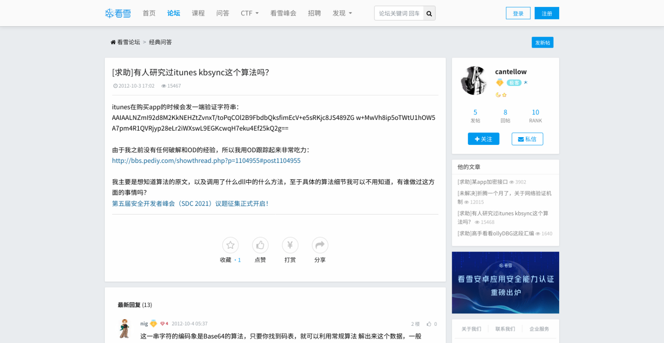
kbsync, you say?
https://bbs.pediy.com/thread-156752.htm

Slide 40
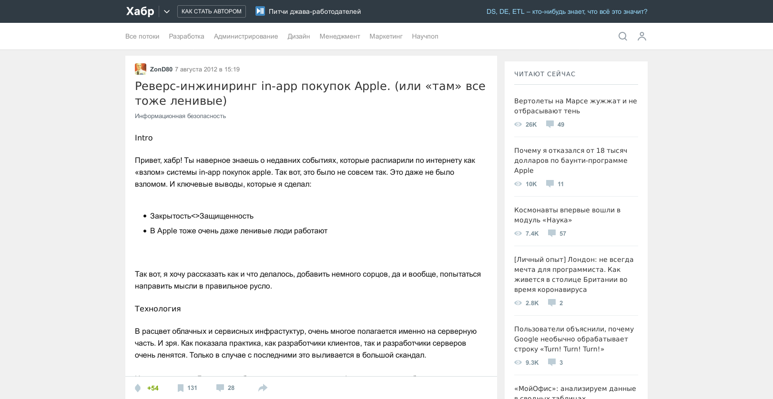
kbsync, you say?
https://habr.com/ru/post/149207/

Slide 41
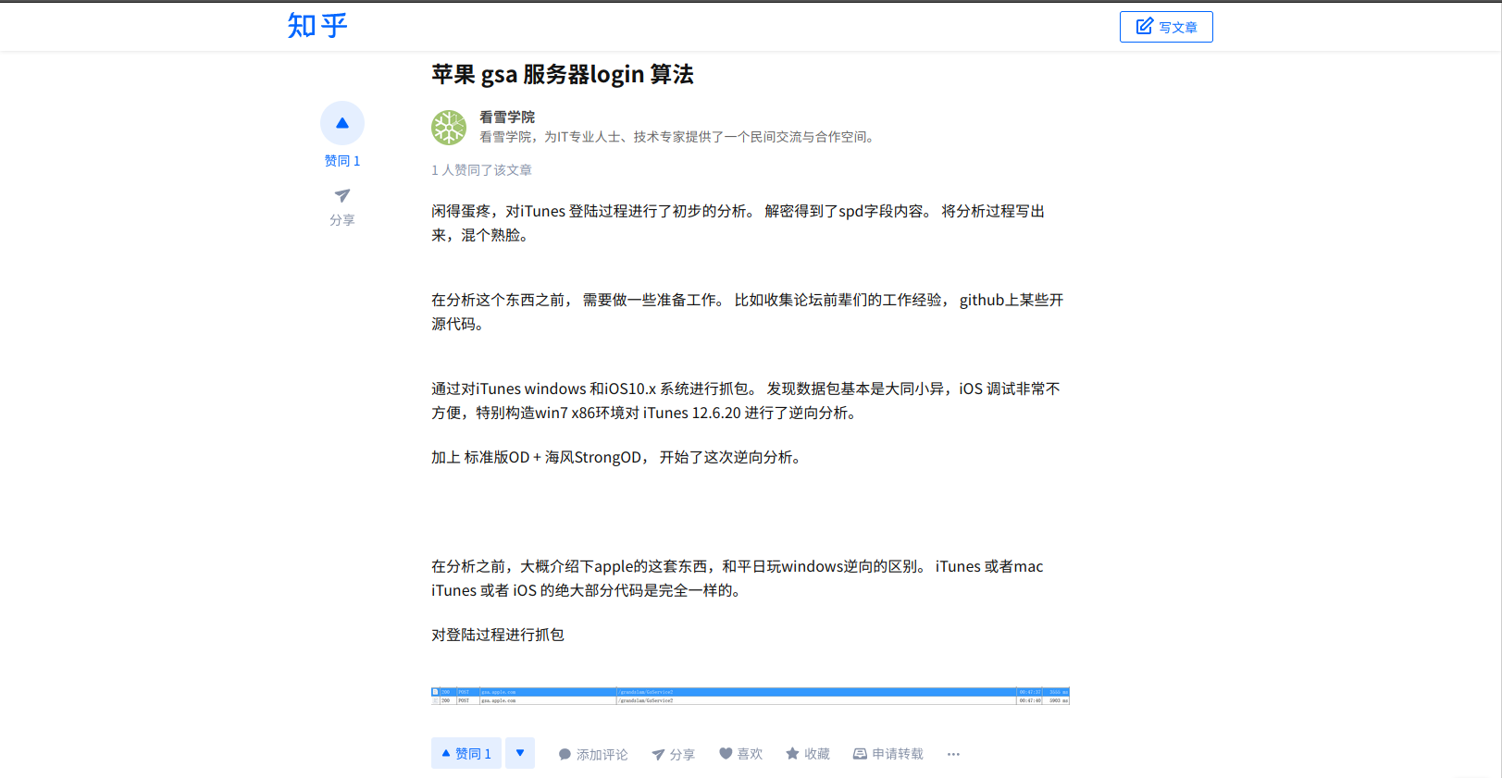
kbsync, you say?
https://www.zhihu.com/column/p/29278195

Slide 42
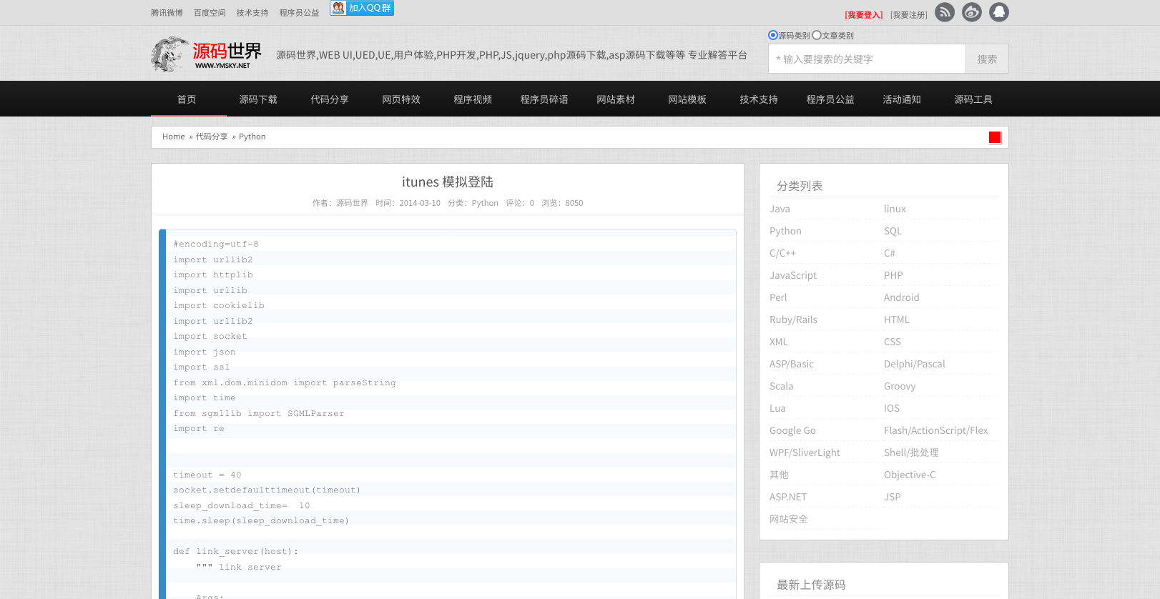
So close and yet so far…
http://www.ymsky.net/views/64756.shtml

Slide 43
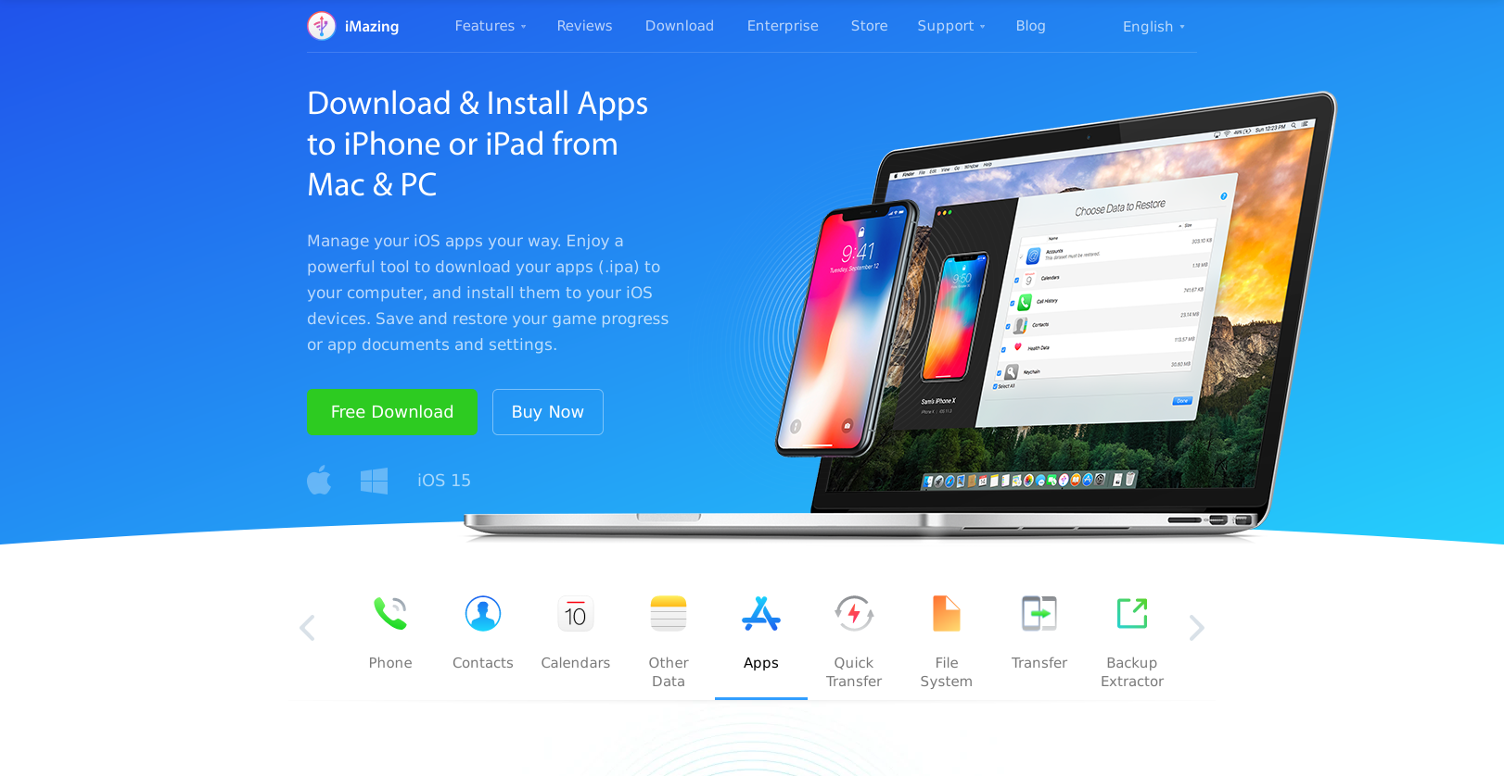
Some one else must have figured this out, right?
https://imazing.com/ios-app-management

Slide 44
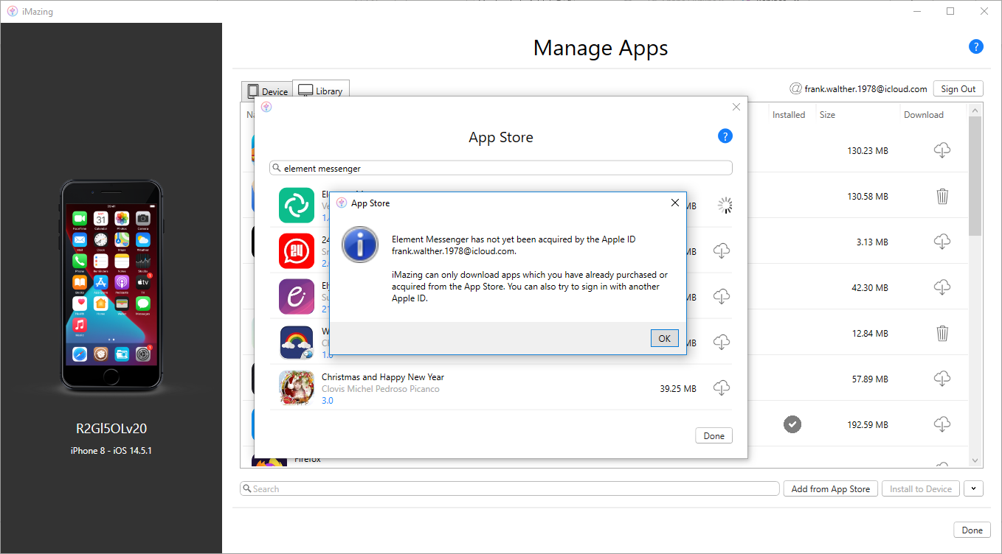
Not so iMazing, after all

Slide 45
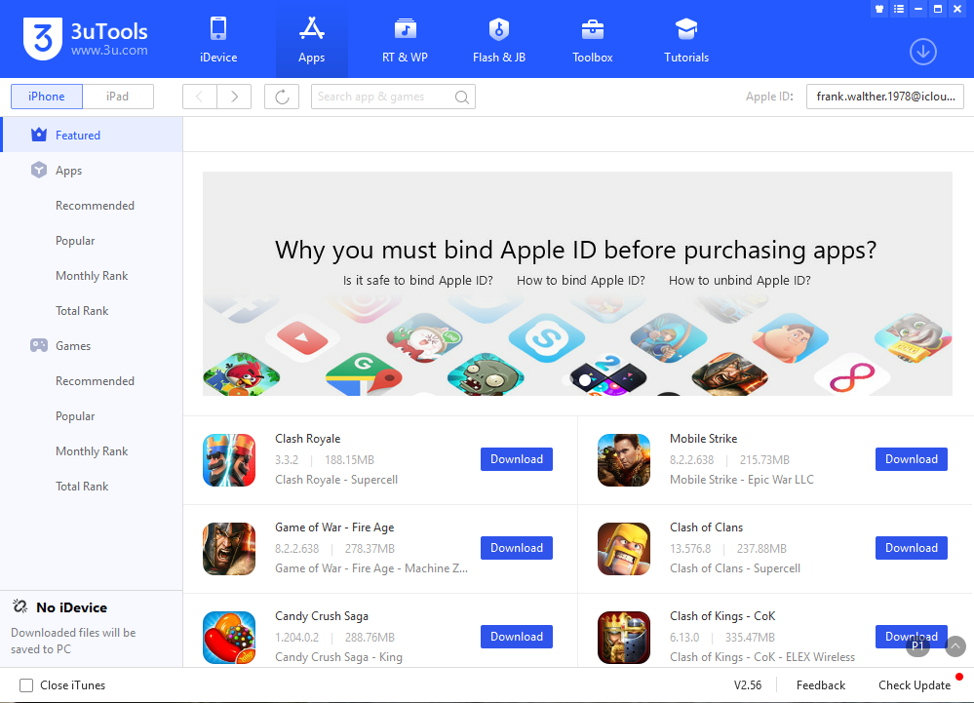
3uTools saves the day

Slide 46
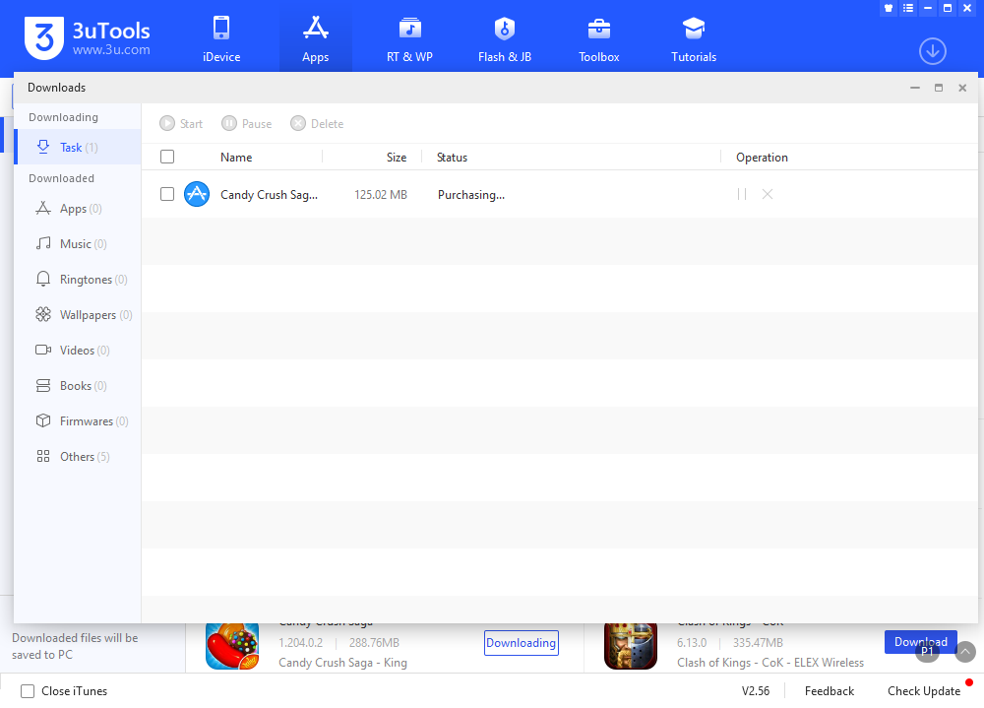
3uTools saves the day

Slide 47
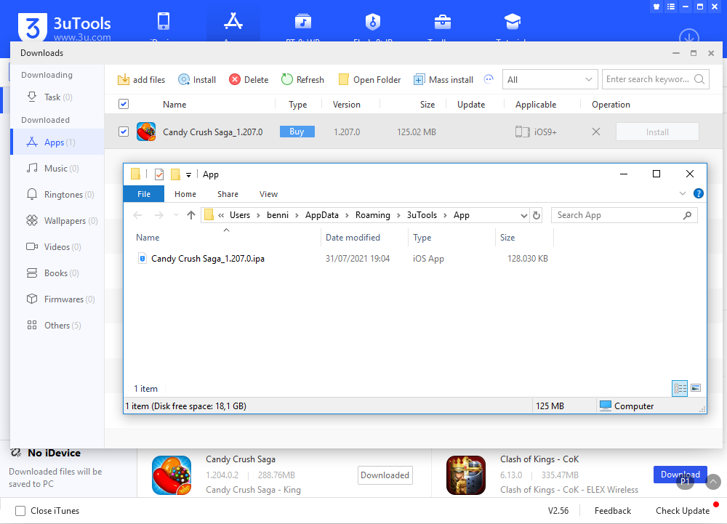
3uTools saves the day

Slide 48
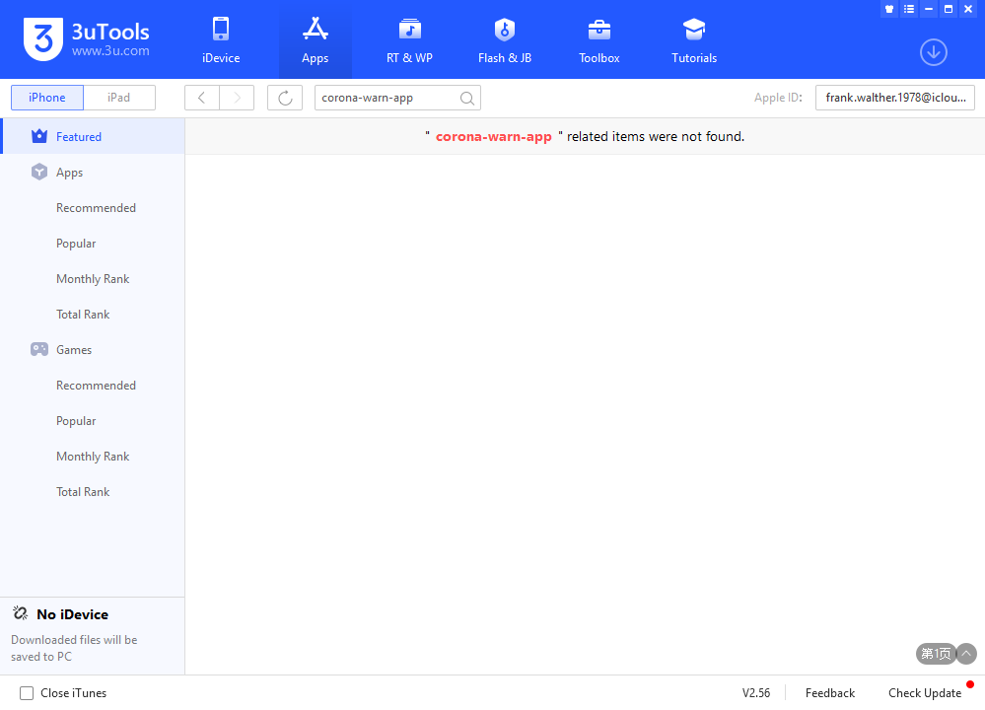
A final road block

Slide 49
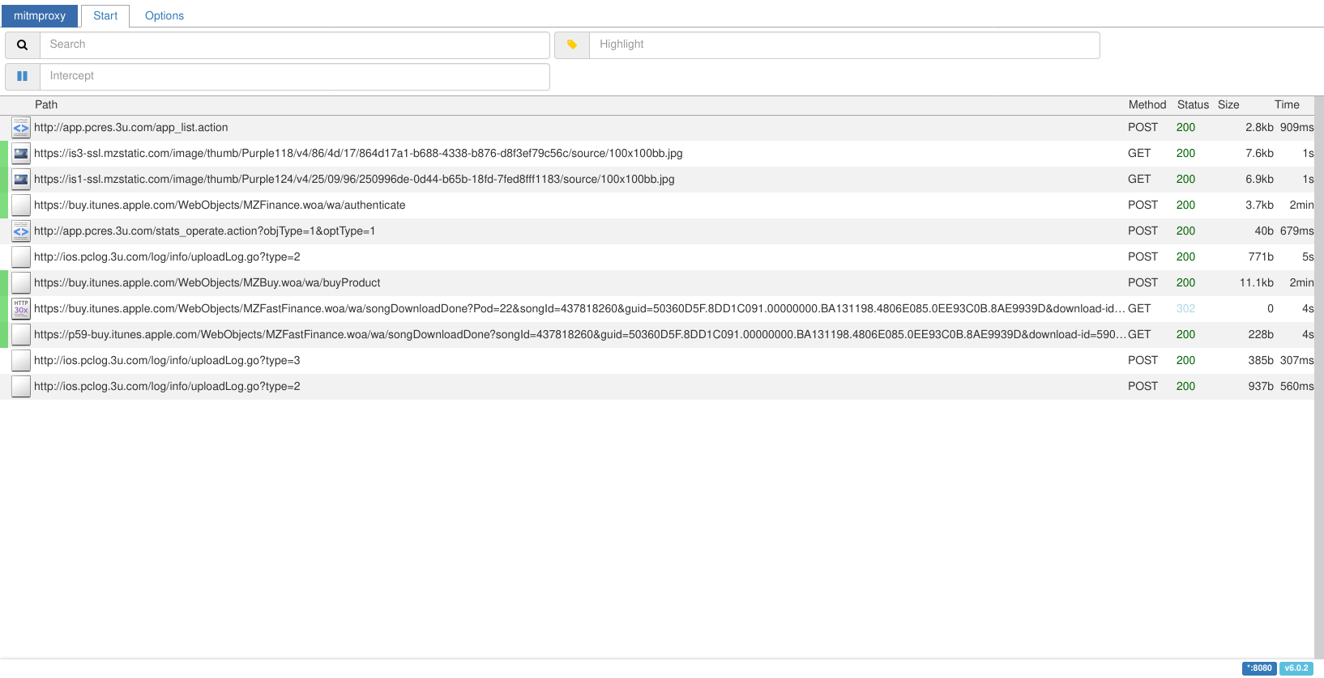
Or just a minor hurdle?

Slide 50
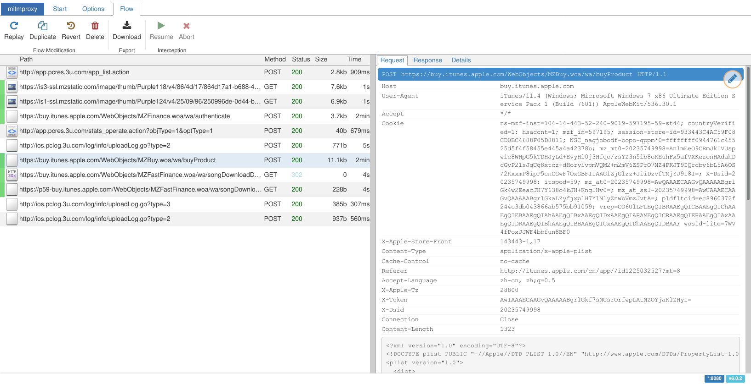
Doesn’t that request look familiar?

Slide 51
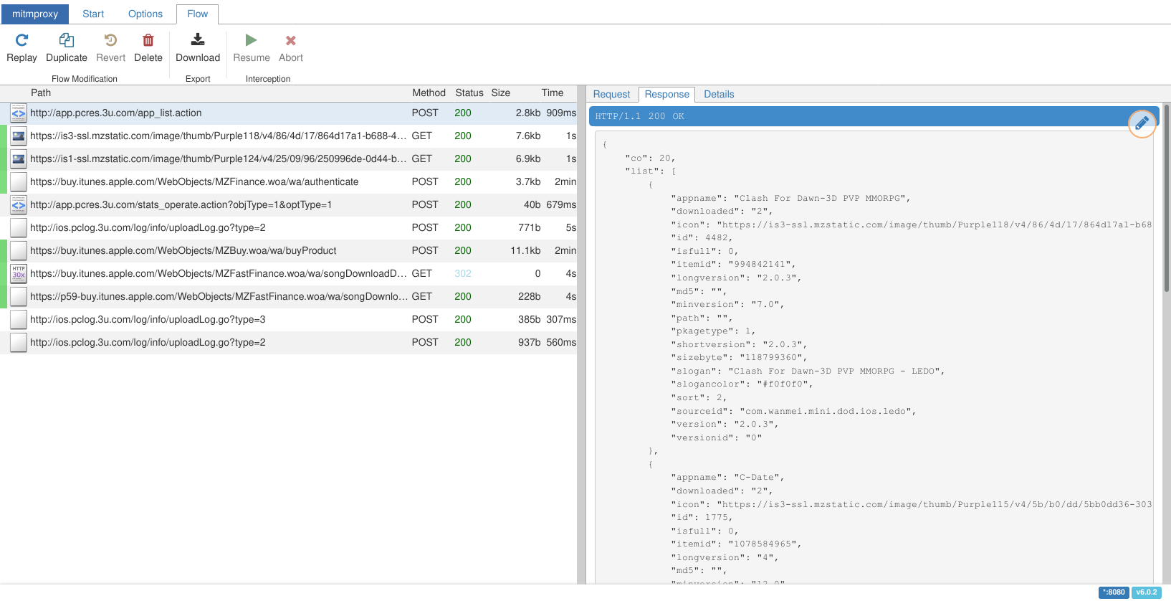
We’ve identified our hurdle

Slide 52
The only logical solution
def response(self, flow: http.HTTPFlow): if(flow.request.pretty_url == "http://app.pcres.3u.com/app_list.action"): i = int(flow.request.urlencoded_form.get("page")) - 1 apps = self.apps[0+i*20:20+i*20] res_apps = [{ "versionid": "0", "icon": f"https://via.placeholder.com/100?text={a['buyData']['bundle-id']}", "itemid": a['id'], "id": idx + i * 20, "slogancolor": "#f0f0f0", "appname": a['name'], "sourceid": a['buyData']['bundle-id'], "minversion": a['buyData']['minimum-os-version'], "sizebyte": a['buyData']['file-size'], "longversion": a['buyData']['minimum-os-version'], # […] } for idx, a in enumerate(apps)] res = { "success": True, "type": 104, "list": res_apps, "co": 20 } flow.response.content = json.dumps(res).encode("utf-8")

Slide 53
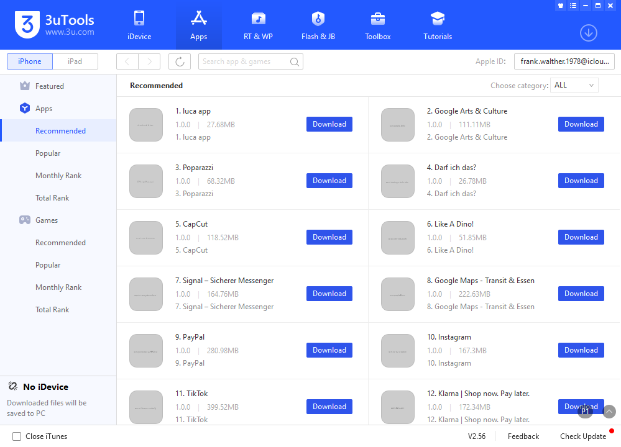
An improved 3uTools

Slide 54
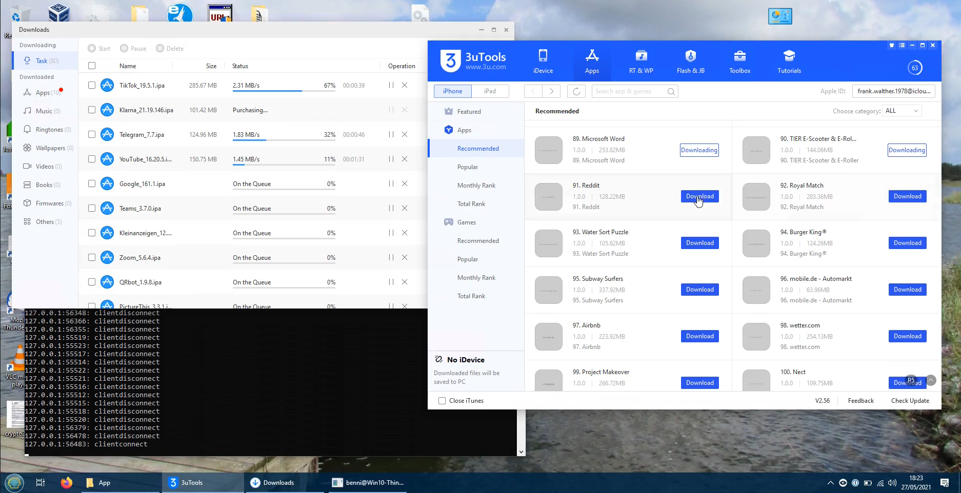
Click, click, click…

Slide 55
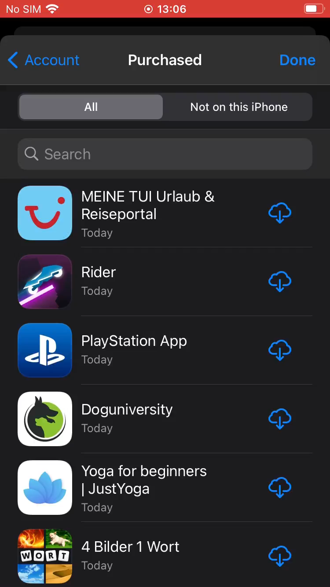
The reward

Slide 56
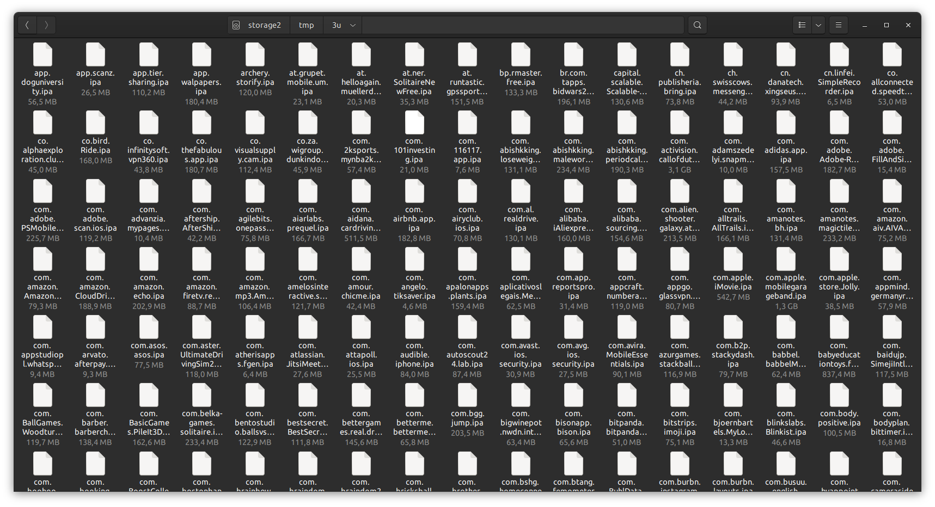
The (way) better reward

Slide 57
Automation
On macOS, Configurator can be scripted:
cfgutil install-app "<file.ipa>"
cfgutil remove-app "<bundle_id>"

Slide 58

Automation
https://libimobiledevice.org/

Slide 59
Automation
On macOS, Configurator can be scripted:
cfgutil install-app "<file.ipa>"
cfgutil remove-app "<bundle_id>"
On Linux, we use libimobiledevice:
ideviceinstaller --install "<file.ipa>"
ideviceinstaller --uninstall "<bundle_id>"

Slide 60

Automation
https://cydia.saurik.com/package/libactivator/

Slide 61
Automation
On macOS, Configurator can be scripted:
cfgutil install-app "<file.ipa>"
cfgutil remove-app "<bundle_id>"
On Linux, we use libimobiledevice:
ideviceinstaller --install "<file.ipa>"
ideviceinstaller --uninstall "<bundle_id>"
For the rest, we SSH into the device and use Activator:
activator send libactivator.system.homebutton
activator send "<bundle_id>"
activator listeners

Slide 62

Automatically granting permissions
https://objective-see.com/blog/blog_0x4C.html

Slide 63

Automatically granting permissions

Slide 64

Automatically granting permissions
auth_value == 0: permission not granted
auth_value == 2: permission granted

Slide 65

Automatically granting permissions

Slide 66
The available permissions
 | service | Label in Settings | Description
✓ | kTCCServiceCalendar | Calendars | “Access Your Calendar”
✓ | kTCCServiceAddressBook | Contacts | “Access Your Contacts”
✓ | kTCCServiceReminders | Reminders | “Access Your Reminders”
✓ | kTCCServicePhotos | Photos (All Photos) | “Access your photos”
✗ | kTCCServicePhotosAdd | Photos (Add Photos Only) | “Add to your Photos”
✓ | kTCCServiceMediaLibrary | Media & Apple Music | “Access Apple Music, your music and video activity, and your media library”
✓ | kTCCServiceBluetoothAlways | Bluetooth | “Find and connect to Bluetooth accessories. This app may also use Bluetooth to know when you’re nearby.”
☐ | kTCCServiceSpeechRecognition | Speech Recognition | “Access Speech Recognition”, “Speech data from this app will be sent to Apple to process your requests. This will also help Apple improve its speech recognition technology.”
✓ | kTCCServiceMotion | Motion & Fitness | “Access Your Motion & Fitness Activity”
✗ | kTCCServiceCamera | Camera | “Access the Camera”
✗ | kTCCServiceMicrophone | Microphone | “Access the Microphone”
✓ | kTCCServiceWillow | Home Data | “Access Your Home Data”

Slide 67
The available permissions (cont’d)
 | service | Label in Settings | Description
✗ | kTCCServiceUserTracking | Allow Tracking | “Track your activity across other companies’ apps and websites”
☐ | kTCCServiceWebKitIntelligentTracking Prevention | Allow Cross-Website Tracking | 0 means do allow, 2 means don’t allow
✓ | kTCCServiceLiverpool | no visible effect | maybe related to location access
✓ | kTCCServiceUbiquity | no visible effect | maybe related to iCloud
☐ | kTCCServiceSensorKitBedSensingWriting | no visible effect | “Add Data for Research Purposes”, “Record bed sensing Sensor & Usage data”
☐ | kTCCServiceGameCenterFriends | no visible effect | “Connect you with your Game Center friends”
☐ | kTCCServicePrototype3Rights | no visible effect | “Authorization to Test Service Proto3Right”
☐ | kTCCServicePrototype4Rights | no visible effect | “Authorization to Test Service Proto4Right”
☐ | kTCCServiceFallDetection | no visible effect | “Receive data from Apple Watch if a fall is detected and follow up in case help is needed”
☐ | kTCCServiceSiri | no visible effect | “Some of your %@ data will be sent to Apple to process your requests.”
☐ | kTCCServiceBluetoothPeripheral | no visible effect | “Make data available to nearby Bluetooth devices even when you’re not using the app”
☐ | kTCCServiceCalls | no visible effect | “Receive VoIP Calls in the Background”
✓ | kTCCServiceExposureNotification | Exposure Notifications | “Your iPhone can securely collect and share random IDs with nearby devices. The app can use these IDs to notify you if you may have been exposed to COVID-19. The date, duration, and signal strength of an exposure will be shared.”

Slide 68

ALL THE PERMISSIONS!

Slide 69
We’re missing the location permission
#/bin/bash # Adapted after: https://stackoverflow.com/a/53875499 and
https://stackoverflow.com/a/29548123 NEEDLE="com.bryceco.GoMap" find / -name '*.db' -print0 | while IFS= read -r -d '' file; do for X in $(sqlite3 $file .tables); do sqlite3 $file "SELECT * FROM $X;" | grep >/dev/null $NEEDLE && echo "Found in file '$file', table '$X'"; done done

Slide 70
It’s not quite as simple
Found in file '/private/var/mobile/Library/Caches/com.apple.appstored/storeUser.db', table
'launch_events'
Found in file '/private/var/mobile/Library/Caches/com.apple.appstored/storeUser.db', table
'purchase_history_apps'
Found in file '/private/var/mobile/Library/Caches/com.apple.appstored/storeUser.db', table
'current_apps_crossfire'
Found in file '/private/var/mobile/Library/TCC/TCC.db', table 'access'
Found in file '/private/var/mobile/Library/DuetExpertCenter/_ATXDataStore.db', table
'anchorModelTrainingData'
Found in file '/private/var/mobile/Library/DuetExpertCenter/_ATXDataStore.db', table
'appInfo'
Found in file '/private/var/mobile/Library/FrontBoard/applicationState.db', table
'application_identifier_tab'
Found in file '/private/var/mobile/Library/FrontBoard/applicationState.db', table
'kvs_debug'
Found in file '/private/var/mobile/Library/CoreDuet/Knowledge/knowledgeC.db', table
'ZOBJECT'
Found in file '/private/var/Keychains/Analytics/trust_analytics.db', table 'hard_failures'

Slide 71

Do we have to dust off our Objective C skills?
https://github.com/lucaIz-ldx/ForceReset/blob/de004718c1ebde9a80dc686040853089ceea20a0/Tweak.x#L151-L155

Slide 72

Enter Frida
https://frida.re/

Slide 73

Frida is great

Slide 74

Frida is (really!) great

Slide 75
Programmatically setting the location permission
To set the location permission using Frida (in the context of the Settings app): ObjC.classes.CLLocationManager .setAuthorizationStatusByType_forBundleIdentifier_( <value>, "<bundle_id>" );
Empirically determined values:
0: Ask every time, 2: Never, 3: Always, 4: While using the app
To check: ​// For the running app. ObjC.classes.CLLocationManager.authorizationStatus(); // For an arbitrary app. ObjC.classes.CLLocationManager .authorizationStatusForBundleIdentifier_("<bundle_id>");

Slide 76


(Truly) ALL THE PERMISSIONS!

Slide 77
Programmatically seeding the clipboard
Knowing that, seeding the keyboard is easy: ObjC.classes.UIPasteboard.generalPasteboard() .setString_("<string>");

Slide 78

Background noise filter
https://support.apple.com/en-us/HT210060

Slide 79

Background noise filter
https://support.apple.com/en-us/HT210060

Slide 80

A first look
Image: Dmitry Ratushny (Unsplash license)
Is iOS really more privacy-friendly than Android?

Slide 81

https://apps.apple.com/us/app/audible-audiobooks-podcasts/id379693831

Slide 82

Audible
POST https://control.kochava.com/track/json
"action": "install", "sdk_protocol": "16", "data": { "os_version": "iOS 14.5.1", "device": "iPhone10,4",
"disp_h": 1334, "disp_w": 750, "device_model": "iPhone", "identity_link": {
"marketingcloudvisitorid":
"49728088823015189425548504973918371147"
}, "app_short_string": "3.48", "app_name": "Audible", "locale": "en_DE", "device_orientation": "portrait", "is_genuine": false, "uptime": 0.2443, "app_limit_tracking": true, "usertime": 1624132516, "device_limit_tracking": true, "volume": 0.125, "network_conn_type": "wifi",
"bms": 1621257545080,
"notifications_enabled": true, "idfv": "02185687-FB54-4F8E-82C5-5E6DE159943D", "system_ua":
"Mozilla/5.0 (iPhone; CPU iPhone OS 14_5_1
like Mac OS X) AppleWebKit/605.1.15 (KHTML,
like Gecko) Mobile/15E148", "screen_brightness": 0.0226, "ad_services_token_time": 1624132516, "battery_level": 100, "package": "com.audible.iphone", "language": "en-DE", "app_tracking_transparency": { "att": false }, "battery_status": "full", "app_version": "665", "timezone": "Europe/Berlin" }, "nt_id":
"F6CB7FBC-51E89335-4608-4D00-8BCD-4EC76055F160", "kochava_device_id":
"KI1624132516T5FA1F93998744B36880D477DB976FB15", "send_date": "2021-06-19T19:55:17.731Z", "sdk_version": "iOSTracker 4.5.0"

Slide 83

https://apps.apple.com/us/app/paypal-mobile-cash/id283646709

Slide 84
PayPal
POST https://api-m.paypal.com/v1/mfsauth/proxy-auth/token
"app_id": "com.yourcompany.PPClient", "app_guid": "8384FB18-571B-44F0-9809-40F040EB0961", "source_app_version": "7.40.5", "cloud_identifier":
"a2a058f2-9367-4920-8190-bc504b4c90d9", "local_identifier":
"8b8cc6fa-aa04-4109-a27d-ae957c8db00d", "linker_id": "71842c5e-88c0-45c7-a482-0a9cb9d71d58", "risk_comp_session_id":
"26afa6d4-1b33-483f-ba2e-169d431f75a2", "dc_id": "b07f13e37dde7971d431b95a263a55f0", "timestamp": 1624222636861, "device_uptime": 807997862, "locale_lang": "en", "device_name": "R2Gl5OLv20", "os_type": "iOS", "os_version": "14.5.1", "device_model": "iPhone10,4", "is_rooted": true, "is_emulator": false, "TouchIDEnrolled": "false", "PasscodeSet": "true",
"email_configured": true,
"sms_enabled": true,
"location_auth_status": "authorizedWhenInUse", "total_storage_space": 127968497664, "tz_name": "Europe/Berlin", "conn_type": "wifi", "ssid": "WLAN3.ALTPETER.ME", "bssid": "34:81:c4:dc:36:1", "ip_addresses": [ "10.0.0.83", "fd31:4159::cf9:d932:11c3:bede", "fd31:4159::5998:c752:9f96:5e30", "fd31:4159::30a2:88d6:66c9:125f", "2003:dd:af1c:ab00:cc6:9a3a:7bf5:90d7", "2003:dd:af1c:ab00:69d6:4c4d:cabc:5168", "2003:dd:af1c:ab00:c81:68e1:2199:631", "fd31:4159::c9a3:68ec:ea3f:f085", "fe80::f631:960f:130f:5dc1", "fe80::87bf:b362:c6d3:616f" ], "proxy_setting":
"host=10.0.0.68,port=8080,type=kCFProxyTypeHTTPS", "location": {
"lng": 10.564191494436333,
"lat": 52.23529052734375, "acc": 65
}

Slide 85

https://apps.apple.com/us/app/deutsche-bank-phototan/id937259592

Slide 86
DB photoTAN
POST https://col.eum-appdynamics.com/
eumcollector/mobileMetrics?version=2
{ "imageUUID": "bf3b96c2bd3b390ebfcf33656588c86e", "baseAddress": 4372971520, "imageSize": 16384, "codeType": { "type": 16777228, "subType": 0 }, "imagePath":
"/usr/lib/substrate/SubstrateBootstrap.dylib" }, { "imageUUID": "d8c72cfc1da53dc497b2ce83171e108d", "baseAddress": 7156641792, "imageSize": 958464, "codeType": { "type": 16777228, "subType": 0 }, "imagePath":
"/System/Library/Frameworks/CoreTelephony.frame
work/CoreTelephony" },
// […] ]
"cpuCount": 6, "av": "3.1.3", "mv": "3.1.3.5.0", "dmo": "iPhone10,4", "sessionCounter": -1, "images": [ { "imageUUID": "b2b882c11d213146ae3009417cdd3bb5", "baseAddress": 4367171584, "imageSize": 4472832, "codeType": { "type": 16777228, "subType": 0 }, "imagePath":
"/private/var/containers/Bundle/Application/5D1
D54AD-3A7E-4261-9665-3B34DECF590F/DB_PhotoTAN_
PROD.app/DB_PhotoTAN_PROD" },

Slide 87

https://apps.apple.com/us/app/ebay-buy-sell-and-save/id282614216

Slide 88
eBay
POST https://mobiletelemetry.ebay.com/aplsio/v1/error
"appInfo": { "appBuildConfiguration": "release", "appBuildIdentifier": "2412", "appVersion": "6.17.0", "appVersionHash":
"9IA9pz28zzmAnmHWcQ2sZ4NyjbaS4ReTNZxmKena51kpCIu
9fSNBQfaBKWx3QNL72HZtRQCIFufs1hn0VRBBAw==", "vendorAppId": "com.ebay.iphone" }, "deviceInfo": { "clientType": "mobile", "emulator": false, "localeIdentifier": "en_DE", "lowPowerModeEnabled": false, "manufacturer": "Apple", "model": "iPhone10,4", "osName": "iOS", "osVersion": "14.5.1", "physicalMemory": 2070495232, "processorArchitecture": "arm", "processorCount": 6, "processorWordSize": 64,
"systemUptime": 763195.016,
"thermalState": "nominal", "timeZone": "Europe/Berlin", "userLanguage": "en" }, "ebayConfiguration": { "configVersion": "W/\"77\"", "countryCode": "de", "environment": "production", "globalId": "EBAY-DE", "mrollp": 75.58 }, "networkInfo": [{ "constrained": false, "expensive": false, "network": "wifi", "networkScore": 0.6, "networkSubtype": "unknown", "supportsIPv4": true, "supportsIPv6": true }], "sessionGuid": "288af0e417aedc9e31a7cf4001d35186", "userInfo": {
"deviceGuid": "288aed6817a35f1f474999b001568ca8" }

Slide 89

https://apps.apple.com/us/app/hill-climb-racing/id564540143

Slide 90
Hill Climb Racing
POST https://live.chartboost.com/api/config
"device_name": "R2Gl5OLv20", "dark_mode": true, "timezone": "GMT+02:00", "disk_space": 115240787968, "use_metric": true, "currency": "EUR", "os": "14.5.1", "audio_output_type": ["Speaker"], "h": 750, "w": 1334, "country": "DE", "carrier": { "mobile_network_code": null, "iso_country_code": null, "mobile_country_code": null, "carrier_name": null }, "screen_fps": 60, "last_bootup": 1621257545, "session_ID":
"87e8c86f7fa2ee329a72d15a618676d70b25a811",
"calendar": "gregorian",
"scr_up_time": 765422, "audio_input_name": [], "input_language": ["en-GB", "de-DE", "emoji"], "incr_contrast": false, "total_disk": 127968497664, "audio_volume": 0.125, "rooted_device": true, "screen_bright": 0.35547930002212524, "is_portrait": false, "charging": false, "device_type": "iPhone10,4", "audio_input_type": [], "model": "iPhone", "language": "en-DE", "mobile_network": 0, "audio_output_name": ["Speaker"], "limit_ad_tracking": true, "retina": true, "identity":
"eyJpZmEiOiIwMDAwMDAwMC0wMDAwLTAwMDAtMDAwMC0wMDAwM
DAwMDAwMDAiLCJpZnYiOiIyNDgzMzRERS1EMjc5LTQ5OTQtQU
Q0QS04RDQzMUQwNkUxMjkiLCJjYl9pZCI6IlF6QXhNVE5EUlV
JdE1VRTJSQzAwTlRkQkxVRTFSall0TWtFM01FRXpPVFZETUVK
RSJ9"

Slide 91

https://apps.apple.com/us/app/pacer-pedometer-step-tracker/id600446812

Slide 92
Pacer
POST https://api.pacer.cc/pacer/ios/api/v19/accounts/0/location
client_time=2021-06-20T17:34:30.162+02:00&client_timezone_offset=120&system_location={ "sub_locality_level_1": "Südstadt-Rautheim", "iso_country_code": "DE", "administrative_area": "Lower Saxony", "extras": null, "formatted_address": "Schreinerweg 738126 BraunschweigGermany", "sub_thoroughfare": "7", "thoroughfare": "Schreinerweg", "display_name": "Südstadt-Rautheim, Braunschweig", "timezone_name": "Europe\/Berlin", "sub_administrative_area": "Brunswick", "postal_code": "38126", "coordinate": { "longitude": 10.564214352048731, "latitude": 52.235299152630958 }, "country": "Germany", "name": "Schreinerweg 7", "locality": "Braunschweig" }

Slide 93

https://apps.apple.com/us/app/newsbreak-local-everything/id1132762804

Slide 94
NewsBreak
GET https://api.newsbreakapp.de/Website/user/binding-location
accuracy=53.29285929263329
appid=newsbreak
countries=DE
cv=17.0.0.71
deviceID=0EC765F5-5CCE-44D2-8CF5-B3458F258E11
device_id_ios=0EC765F5-5CCE-44D2-8CF5-B3458F258E11
distribution=com.apple.Appstore
geo_data={
"locality": "Braunschweig", "country": "Deutschland", "subLocality": "Südstadt-Rautheim",
"subThoroughfare":"7", "administrativeArea": "Niedersachsen", "ISOcountryCode": "DE",
"postalCode": "38126", "thoroughfare": "Schreinerweg"
}
languages=de
latitude=52.23529241882057
longitude=10.56423577475987
net=wifi
pf_token_id=000J4bYK
platform=0
profile_id=000J4bYK
version=020066

Slide 95

https://apps.apple.com/us/app/4-pics-1-word/id595558452

Slide 96
4 Pics 1 Word
POST https://graph.facebook.com/network_ads_common/
"ANON_ID": "XZ79F5056E-A25F-4016-BC4B-B36C2AC15F22",
"SCREEN_HEIGHT": "667", "SCREEN_WIDTH": "375",
"ORIENTATION": "3", "ROOTED": "2", "LOCALE": "de_DE", "IDFA_FLAG": "0", "UNITY": "0", "DATA_PROCESSING_OPTIONS_STATE": "null", "DEBUGGER_ATTACHED": "0", "COCOS2D": "0", "MEDIATION_SERVICE":
"GOOGLE_afma-sdk-i-v7.69.0: 6.2.1.0", "BUNDLE": "de.lotum.4pics1word", "DATA_PROCESSING_OPTIONS_COUNTRY": "null", "DENSITY": "2", "AD_EXPERIENCE_TYPE":
"ad_experience_config_rewarded", "OS": "iOS", "FUNNEL_CORE_EVENTS":
"4101,4146,4127,4106,4123,4104,4410,4412,4411",
"VOLUME": "0.125", "MODEL": "iPhone10,4", "MAKE": "Apple",
"ANALOG":
"{\"free_space\":111712808960,\"charging\":1,
\"accelerometer_x\":0.025421142578125,
\"available_memory\":16793600,
\"rotation_z\":-0.0018479675054550171,
\"rotation_y\":0.0037262949626892805,
\"rotation_x\":-0.0040666470304131508,
\"accelerometer_z\":-1.0014801025390625,\"battery\":100,
\"accelerometer_y\":0.0040130615234375,
\"total_memory\":2070495232}", "COPPA": "0", "USER_AGENT":
"Mozilla/5.0 (iPhone; CPU iPhone OS 14_5_1 like MacOS X)
AppleWebKit/605.1.15 (KHTML, like Gecko)Mobile/15E148
[FBAN/AudienceNetworkForiOS;FBDV/iPhone10,4;FBMD/D201AP;
FBSN/iOS;FBSV/14.5.1;FBLC/de_DE;FBVS/6.2.1;FBAB/de.lotum
.4pics1word;FBAV/60.14.1;FBBV/60170]", "PLACEMENT_ID": "417220471689883_2814853778593195", "LINKED_WITH_IOS_14_OR_ABOVE": "1", "EVENTS_SEND_ATTEMPTS": "0", "NUM_ADS_REQUESTED": "1", "SESSION_ID": "422D74C5-61BC-45EB-AB7E-F94EFF53D5D3", "IDFA": "00000000-0000-0000-0000-000000000000", "APPVERS": "60.14.1", "OSVERS": "14.5.1"

Slide 97

https://apps.apple.com/us/app/pons-translate/id577741918

Slide 98
PONS
GET https://api.pons.com
/dict/search/autocomplete-json?q=LDDsvPqQdT&l=deen&lang=en-US

Slide 99

https://apps.apple.com/us/app/poparazzi/id1513680970

Slide 100
Poparazzi
POST https://poparazzi.com/api/contacts
"data": [ { "attributes": { "is_profile_photo": true, "last_name": "TBFFZbBYea", "phone_numbers": ["+4915557543434"], "full_name": "JGKfozntbF TBFFZbBYea", "clean_name": "JGKfozntbF TBFFZbBYea", "is_emoji": false, "first_name": "JGKfozntbF" }, "type": "contacts", "id": "3A575DFF-C7FC-4F13-B40D-89D52F208C15:ABPerson" } ]

Slide 101

Results
Image: National Cancer Institute (Unsplash license)

Slide 102


Statistics
1,001 apps from the “Top 1200 Free Apps” for Germany as of May 27, 2021
Analysis done on an iPhone 8 running iOS 14.5.1
74 apps without any requests, including:
Signal - Private Messenger
TeleGuard
Commerzbank photoTAN
AusweisApp2
Facebook
ZOOM Cloud Meetings

Slide 103


Requests per app
Number of network requests per app on iOS.
Number of network requests per app on Android [Altpeter, Wessels].

Slide 104


Hosts per app
Number of unique hosts requested per app on iOS.
Number of unique hosts requested per app on Android [Altpeter, Wessels].

Slide 105


Requests blocked by tracking filter lists
Total requests: 34,925, requests after filtering: 30,439 (87.16%)
Number of requests blocked per app on iOS when using these tracking filter lists: EasyPrivacy, eulaurarien, Perflyst.
Number of requests blocked per app on Android when using these tracking filter lists: EasyPrivacy, eulaurarien, Perflyst [Altpeter, Wessels].

Slide 106


Requests blocked by tracking filter lists
Ratio of requests blocked per app on iOS when using these tracking filter lists: EasyPrivacy, eulaurarien, Perflyst.
Ratio of requests blocked per app on Android when using these tracking filter lists: EasyPrivacy, eulaurarien, Perflyst [Altpeter, Wessels].

Slide 107

Requests blocked by tracking filter lists
Ratio of requests blocked by tracking filter lists per top list position of the apps, interactive version: https://www.datawrapper.de/_/8tvtM/

Slide 108


Requests to third-party tracking servers
Number of apps contacting the most common third-party tracking servers on iOS, based on Exodus tracker database.
Number of apps contacting the most common third-party tracking servers on Android, based on Exodus tracker database [Altpeter, Wessels].

Slide 109

Where are the trackers based?
USA
Israel
China
United Kingdom
Germany
Number of apps contacting the most common third-party tracking servers on iOS and the respective countries, based on Exodus tracker database and Datenanfragen.de company database.

Slide 110
Honey data
Owner: Frank Walther, frank.walther.1978@icloud.com
Contact: JGKfozntbF TBFFZbBYea, 0155 57543434, RYnlSPbEYh@bn.al, https://q8phlLSJgq.de, N2AsWEMI5D 565, 859663 p0GdKDTbYV
Messages: 9FBqD2CNIJ to +4917691377604
Photos, videos, and screenshots
Clipboard: LDDsvPqQdT
Calendar: fWAs4GFbpN, at urscf2178L, 2021-08-14T08:56 – 2021-08-17T21:24, repeats every month, alarm
Reminder: b5jHg3Eh1k, HQBOdx4kx2 (scheduled for 2021-08-02T13:38)
Note: S0Ei7sFP9b
Health details: Name DkwIXobsJN t5TfTlezmn, DOB 1973-05-15, female, height 146cm, weight 108.5kg
Home data: Rooms bEZf1h06j1 (with wallpaper photo), DX7BgPtH99 (basement); second home g1bVNue3On (with wallpaper photo)
Location: Schreinerweg 6, 38126 Braunschweig; 52.235288, 10.564235
WiFi network: WLAN3.ALTPETER.ME
Device name: R2Gl5OLv20
Device model: iPhone10,4
OS version: 14.5.1
Model no.: MX162ZD/A
SN: FFMZP87VN1N0
IMEI: 356395106788056
BSSID: 34:81:c4:dc:36:1
WiFi addr: 3C:CD:36:D4:CC:E4
Bluetooth addr: 3C:CD:36:D2:BD:B2
Local IP: 10.0.0.68
Volume level: 0.125
Screen resolution: 1334x750
Disk space: 127968497664
Modem firmware: 4.03.05
SEID: 044B24632…

Slide 111

Indicators
Number of apps with at least one request that includes the respective indicator. Indicators included in plain text or base64-encoded are considered.

Slide 112


IDFA and IDFV
https://developer.apple.com/documentation/adsupport/asidentifiermanager/1614151-advertisingidentifier, https://developer.apple.com/documentation/uikit/uidevice/1620059-identifierforvendor

Slide 113

IDFA and IDFV
https://www.braze.com/docs/developer_guide/platform_integration_guides/ios/ios_14/

Slide 114
Indicators
Number of apps with at least one request that includes the respective indicator. Indicators included in plain text or base64-encoded are considered.

Slide 115

Privacy labels
https://developer.apple.com/app-store/user-privacy-and-data-use/

Slide 116

Privacy labels
https://apps.apple.com/us/app/facebook/id284882215

Slide 117

Privacy labels

Slide 118





Privacy labels
841 of 1001 apps have valid privacy labels. Of those, 32 claim not to collect any data, namely:
TeleGuard
Voice Recorder - Audio Editor⁺
Tik Saver : Tik Tok Downloader
whatspoof fake chat
Stop Motion Studio
WATCHED - Multimedia & Movie
free2pass
Darf ich das?
Moodle
VPN TrackBlock: data safety
PlattinO - Die Plattlern-App
Pureple Outfit Planner
Renpho
Samsung Galaxy Watch (Gear S)
Cisco Webex Meetings
Windscribe VPN
SpiderDoll
Meine AOK
Sicher Reisen
Wahl-O-Mat
ePassGo
DSBmobile
DKB-TAN2go
ElsterSmart
EPICOM
Onlinebefunde
SafeVac
STIKO-App
atWork Timesheet
Re-open EU
Blutspende
Hayat Eve Sığar

Slide 119

Indicators
Number of apps with at least one request that includes the respective indicator as specified by the privacy labels and whether it was declared. Indicators included in plain text or base64-encoded are considered.

Slide 120

Purposes
Number of apps with at least one request for the purpose of tracking or ads as specified by the privacy labels and whether it was declared. Based on Exodus tracker database and most popular ad hosts in data set.

Slide 121
Conclusion
Very similar results for Android and iOS
Similar amount of tracking, covering the same data and through the same third-party companies
Currently major difference w.r.t. ad ID

Slide 122

Conclusion
https://support.google.com/googleplay/android-developer/answer/6048248?hl=en

Slide 123
Conclusion
Very similar results for Android and iOS
Similar amount of tracking, covering the same data and through the same third-party companies
Currently major differences w.r.t. ad ID, but similar changes planned for Android
Apple does at least innovate somewhat, e.g. through privacy labels (pretty accurate)

Slide 124

Conclusion
https://www.imore.com/google-reveals-android-version-apples-privacy-nutrition-labels

Slide 125
Future work
Improve IPA acquisition “framework”
Investigate defenses against tracking in general and metadata extraction in particular
Dive deeper into privacy labels
More sophisticated data analysis

Slide 126
This slide intentionally left blank.

Slide 127
Details about privacy labels
TODO

Slide 128

RegenRadar

Slide 129

RegenRadar

Slide 130
Settings
General
Background App Refresh: off (to hopefully minimize background network traffic)
Privacy
Analytics & Improvements
Share iPhone Analytics: off
Apple Advertising
Personalised Ads: on (default)
App Store
Automatic Downloads
Apps: off
App Updates: off
Display & Brightness
Auto-Lock: never
Turn on Bluetooth.
Uninstall all third-party apps that are not absolutely necessary.

